Slide 1
Saul the First King
Chad Labelle

Slide 2
Historical Context

Slide 3
Outline | Place in Old Testament
Creation
End of OT
4000 ?
OLD TESTAMENT TIMELINE
430
Notes:
[google search “Old Testament Outline” source is “GraceChapelOnline.org” – adapted]

Slide 4
Outline | Place in Old Testament
Creation
The Exodus
Saul 1st King
Fall of Northern Kingdom
End of OT
Call of Abraham
Entrance into Canaan
Division of the Kingdom
Jerusalem Restored
Fall of Southern Kingdom
Time of Judges Begins
4000 ?
2200
1446
1350
1051
931
722
586
515
430
Notes:
[google search “Old Testament Outline” source is “GraceChapelOnline.org” – but can’t get to content – probably behind pay wall, so I should adapt graphic]

Slide 5
Outline | Place in Old Testament
Creation
The Exodus
Saul 1st King
Fall of Northern Kingdom
End of OT
Call of Abraham
Entrance into Canaan
Division of the Kingdom
Jerusalem Restored
Fall of Southern Kingdom
Time of Judges Begins
Patriarchs
Time of Judges
Kings
4000 ?
2200
1446
1350
1051
931
722
586
515
430
Notes:
[google search “Old Testament Outline” source is “GraceChapelOnline.org” – but can’t get to content – probably behind pay wall, so I should adapt graphic]

Slide 6
Outline | Place in Old Testament
Creation
The Exodus
Saul 1st King
Fall of Northern Kingdom
End of OT
Call of Abraham
Entrance into Canaan
Division of the Kingdom
Jerusalem Restored
Fall of Southern Kingdom
Time of Judges Begins
Patriarchs
Time of Judges
Kings
4000 ?
2200
1446
1350
1051
931
722
586
515
430
Job
Joshua
Judges Ruth 1 Samuel 1-7
1 Samuel 8 - 2 Samuel 1 Kings 1-11
1Kings 12 – 2Kings 25 1 & 2 Chronicles Hosea Joes Amos Isaiah Micah Obadiah Jonah Nahum Habakuk Zephaniah
Jeremiah Lamentations Ezekiel
Zechariah Haggai Malachi
Deuteronomy
Genesis 1:1-11:26
Genesis 11:27-50:26
Numbers
Daniel
Leviticus
Psalms Proverbs Ecclesiastes Song of Solomon
Ezra Nehemiah Esther
Exodus
Notes:
[google search “Old Testament Outline” source is “GraceChapelOnline.org” – but can’t get to content – probably behind pay wall, so I should adapt graphic]

Slide 7
Outline | Place in Old Testament
Creation
The Exodus
Saul 1st King
Fall of Northern Kingdom
End of OT
Call of Abraham
Entrance into Canaan
Division of the Kingdom
Jerusalem Restored
Fall of Southern Kingdom
Time of Judges Begins
Patriarchs
Time of Judges
Kings
4000 ?
2200
1446
1350
1051
931
722
586
515
430
Job
Joshua
Judges Ruth 1 Samuel 1-7
1 Samuel 8 - 2 Samuel 1 Kings 1-11
1Kings 12 – 2Kings 25 1 & 2 Chronicles Hosea Joes Amos Isaiah Micah Obadiah Jonah Nahum Habakuk Zephaniah
Jeremiah Lamentations Ezekiel
Zechariah Haggai Malachi
Deuteronomy
1 Samuel 1-7
Genesis 1:1-11:26
Genesis 11:27-50:26
Numbers
Daniel
Leviticus
Psalms Proverbs Ecclesiastes Song of Solomon
Ezra Nehemiah Esther
Exodus
Notes:
[google search “Old Testament Outline” source is “GraceChapelOnline.org” – but can’t get to content – probably behind pay wall, so I should adapt graphic]

Slide 8
Outline | Place in Old Testament
Creation
The Exodus
Saul 1st King
Fall of Northern Kingdom
End of OT
Call of Abraham
Entrance into Canaan
Division of the Kingdom
Jerusalem Restored
Fall of Southern Kingdom
(1 & 2 Samuel)
~1060
~971
Time of Judges Begins
971
Patriarchs
Time of Judges
Kings
4000 ?
2200
1446
1350
1051
931
722
586
515
430
Job
Joshua
Judges Ruth 1 Samuel 1-7
1 Samuel 8 - 2 Samuel 1 Kings 1-11
1Kings 12 – 2Kings 25 1 & 2 Chronicles Hosea Joes Amos Isaiah Micah Obadiah Jonah Nahum Habakuk Zephaniah
Jeremiah Lamentations Ezekiel
Zechariah Haggai Malachi
Deuteronomy
1 Samuel 1-7
Genesis 1:1-11:26
Genesis 11:27-50:26
Numbers
Daniel
Leviticus
Psalms Proverbs Ecclesiastes Song of Solomon
Ezra Nehemiah Esther
Exodus
Notes:
[google search “Old Testament Outline” source is “GraceChapelOnline.org” – but can’t get to content – probably behind pay wall, so I should adapt graphic]

Slide 9
Outline | Place in Old Testament
Creation
The Exodus
Saul 1st King
Fall of Northern Kingdom
End of OT
Call of Abraham
Entrance into Canaan
Division of the Kingdom
Jerusalem Restored
Fall of Southern Kingdom
Today’s Focus (1Samuel 8-31)
~1051
~1011
Time of Judges Begins
1011
Patriarchs
Time of Judges
Kings
4000 ?
2200
1446
1350
1051
931
722
586
515
430
Job
Joshua
Judges Ruth 1 Samuel 1-7
1 Samuel 8 - 2 Samuel 1 Kings 1-11
1Kings 12 – 2Kings 25 1 & 2 Chronicles Hosea Joes Amos Isaiah Micah Obadiah Jonah Nahum Habakuk Zephaniah
Jeremiah Lamentations Ezekiel
Zechariah Haggai Malachi
Deuteronomy
1 Samuel 1-7
Genesis 1:1-11:26
Genesis 11:27-50:26
Numbers
Daniel
Leviticus
Psalms Proverbs Ecclesiastes Song of Solomon
Ezra Nehemiah Esther
Exodus
Notes:
[google search “Old Testament Outline” source is “GraceChapelOnline.org” – but can’t get to content – probably behind pay wall, so I should adapt graphic]

Slide 10
Map

Slide 11
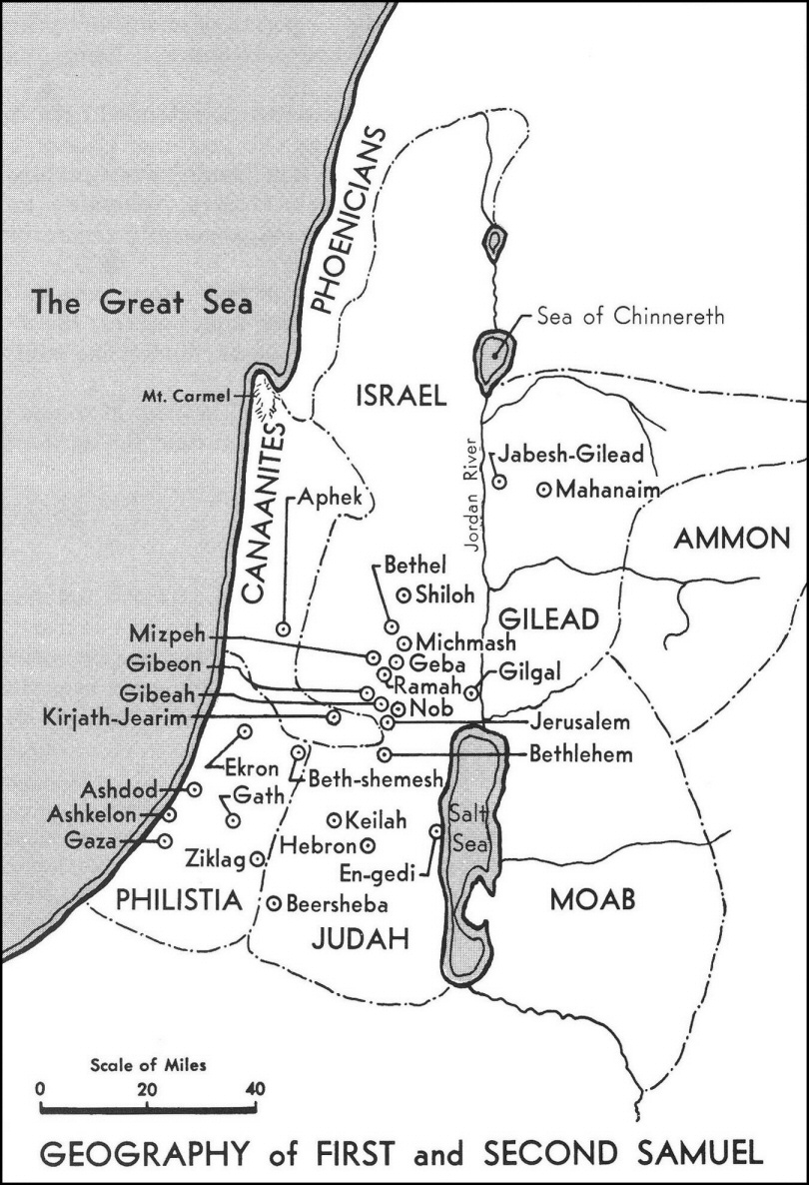
Map
Notes:
https://www.preceptaustin.org/1_samuel_commentaries

Slide 12
Map
Notes:
https://www.preceptaustin.org/1_samuel_commentaries

Slide 13
Map
Ammonites
Philistines
Amalekites
Notes:
https://www.preceptaustin.org/1_samuel_commentaries

Slide 14
Outline

Slide 15
Outline | 1 & 2 Samuel Overview
1-31
1-24
1 SAMUEL
2 SAMUEL
Notes:
[graphic adapted from Bible project]

Slide 16
Outline | 1 & 2 Samuel Overview
1-31
1-24
Samuel
1 SAMUEL
2 SAMUEL
Notes:
[graphic adapted from Bible project]

Slide 17
Outline | 1 & 2 Samuel Overview
1-31
1-24
Saul
Samuel
1 SAMUEL
2 SAMUEL
Notes:
[graphic adapted from Bible project]

Slide 18
Outline | 1 & 2 Samuel Overview
1-31
1-24
Saul
David
Samuel
1 SAMUEL
2 SAMUEL
Notes:
[graphic adapted from Bible project]

Slide 19
Outline | 1 & 2 Samuel Overview
1-7
8-31
1-20
21-24
Samuel
Saul becomes king
David anointed
David’s reign… [next 2 weeks]
…epilogue
Saul
David
Samuel
1 SAMUEL
2 SAMUEL
Notes:
[graphic adapted from Bible project]

Slide 20
Outline | 1 & 2 Samuel Overview
1-7
8-31
1-20
21-24
Samuel
Saul becomes king
David anointed
David’s reign… [next 2 weeks]
…epilogue
Today’s Focus
Saul
David
Samuel
1 SAMUEL
2 SAMUEL
Notes:
[graphic adapted from Bible project]

Slide 21
Outline | Characters: Samuel, Saul & David
 | Chapters in 1 Samuel
 | 1 | 2 | 3 | 4 | 5 | 6 | 7 | 8 | 9 | 10 | 11 | 12 | 13 | 14 | 15 | 16 | 17 | 18 | 19 | 20 | 21 | 22 | 23 | 24 | 25 | 26 | 27 | 28 | 29 | 30 | 31
Samuel
Saul
David

Slide 22
Outline | 1 Samuel 13-31
Israel Demands a King
Saul Chosen to be King
Saul Becomes King
Saul Defeats Ammonites
Samuel’s Farewell
Saul Fights the Philistines Saul Makes an unlawful sacrifice
Jonathan Defeats the Philistines Saul Makes a Rash Vow Saul Fights Israel’s Enemies
The LORD Rejects Saul
David is Anointed King David in Saul’s Service
David & Goliath
David & Jonathan’s Friendship Saul’s Jealousy of David David Marries Michal
Saul Tries to Kill David
Jonathan Warns David
David & the Holy Bread David Flees to Gath
David at the Cave of Adullam Saul Kills the Priests at Nob
David Saves the City of Keilah Saul Pursues David
David Spares Saul’s Life
Death of Samuel David and Abigail
David Spares Saul Again
David Flees to the Philistines
Saul and the Medium of En-dor
The Philistines Reject David
David’s Wives are Captured David Defeats the Amalekites
Death of Saul

Slide 23
Outline | 1 Samuel
1:1 – 4:1 Samuel’s Birth and Call
4:1 – 7:2 The Ark of the Lord
7:3 – 8:22 Samuel the Judge
9:1 – 12:25 Saul the King
13:1 – 15:35 Saul Rejected
16:1 – 17:58 David Anointed
18:1 – 21:9 David Flees Saul
21:10 – 28:2 David in Exile
28:3 – 31:13 Last Days of Saul’s Reign
Notes:
https://www.preceptaustin.org/1_samuel_commentaries

Slide 24
Who Was Saul?

Slide 25
Saul’s Family Tree
Benjamin
Aphiah
Becorath
Zeror
Abiel
Kish
Ner
Saul
Abner
Jonathan
Abinadab
Melchisua
Ish-bosheth
Merab
Michal
Armoni

Slide 26
Saul’s Family Tree
Benjamin
Aphiah
Becorath
Zeror
Abiel
Ner
Kish
Abner
Saul
Jonathan
Abinadab
Melchisua
Ish-bosheth
Merab
Michal
Armoni
Mephibosheth

Slide 27
Saul the King 1Sa 9:1-12:25

Slide 28
Saul the King | 1 Sa 9:1-12:25
Israel Demands a King
Saul Chosen to be King
Saul Becomes King
Saul Defeats the Ammonites
Samuel’s Farewell

Slide 29
Saul Rejected 1Sa 13:1-15:35

Slide 30
Saul Rejected | 1 Sa 13:1-15:35
Saul Fights the Philistines
Saul Makes an Unlawful Sacrifice
Jonathan Defeats the Philistines
Saul Makes a Rash Vow
Saul Fights Israel’s Enemies
The LORD Rejects Saul

Slide 31
Saul Rejected | 1 Sa 13:1-15:35
Saul Fights the Philistines
Saul Makes an Unlawful Sacrifice
Jonathan Defeats the Philistines
Saul Makes a Rash Vow
Saul Fights Israel’s Enemies
The LORD Rejects Saul
“To obey is better than sacrifice” (15:22)

Slide 32
David Anointed 1Sa 16:1-17:58

Slide 33
David Anointed | 1 Sa 16:1 – 17:58
David is Anointed King
David in Saul’s Service
David & Goliath

Slide 34
David Anointed | 1 Sa 16:1 – 17:58
David is Anointed King
David in Saul’s Service
David & Goliath
“man looks on the outward appearance, but the LORD looks on the heart.” (16:7)

Slide 35
David Anointed | 1 Sa 16:1 – 17:58
David is Anointed King
David in Saul’s Service
David & Goliath
“The battle is the LORD’s” (17:47)

Slide 36
David Flees Saul 1Sa 18:1-21:9

Slide 37
David Flees Saul | 1 Sa 18:1 – 21:9
David & Jonathan’s Friendship
Saul’s Jealousy of David
David Marries Michal
Saul Tries to Kill David
Jonathan Warns David

Slide 38
David in Exile 1Sa 21:10-28:2

Slide 39
David in Exile | 1Sa 21:10-28:2
David & the Holy Bread
David Flees to Gath
David at the Cave of Adullam
Saul Kills the Priests at Nob
David Saves the City of Keilah
Saul Pursues David
David Spares Saul’s Life
Death of Samuel

Slide 40
David in Exile | 1Sa 21:10-28:2
David and Abigail
David Spares Saul Again
David Flees to the Philistines

Slide 41
David in Exile | 1Sa 21:10-28:2
David and Abigail
David Spares Saul Again ⬅
David Flees to the Philistines ⬅
“The LORD forbid that I should put out my hand against the LORD’s anointed.” (26:11)

Slide 42
Last Days of Saul’s Reign 1Sa 28:3-31:13

Slide 43
Last Days of Saul’s Reign | 1 Sa 28:3 – 31:13
Saul and the Medium of En-dor
The Philistines Reject David
David’s Wives are Captured
David Defeats the Amalekites
Death of Saul

Slide 44
Last Days of Saul’s Reign | 1 Sa 28:3 – 31:13
Saul and the Medium of En-dor
The Philistines Reject David
David’s Wives are Captured
David Defeats the Amalekites
Death of Saul ⬅
“the LORD has torn the kingdom out of your hand… Because you did not obey the voice of the LORD…” (28:17-18)

Slide 45
Conclusion

Slide 46
Review | 1 Samuel 8-31
Saul was an answer to the people’s demand
Saul v. David
To obey is better than sacrifice (15:22)
The LORD looks on the heart (16:7)
The battle is the LORD’s (17:47)

Slide 47
Key Verse | A Lesson from Saul’s Reign
¹⁶ The king is not saved by his great army;… ¹⁸ Behold, the eye of the Lord is on those who fear him, on those who hope in his steadfast love,
Psalm 33:16,18

