Slide 1
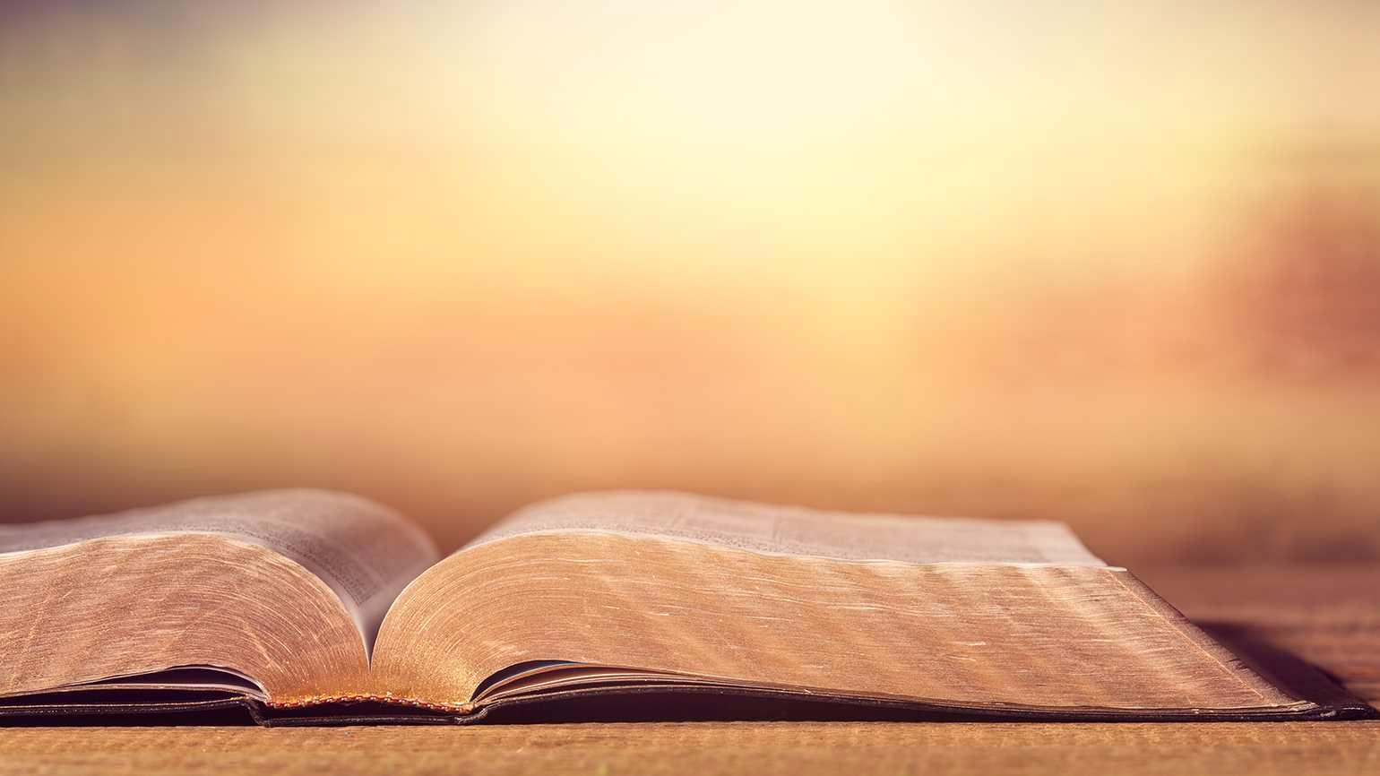
Haggai
Scott Yaekle

Slide 2


Slide 3

Historical Context

Slide 4
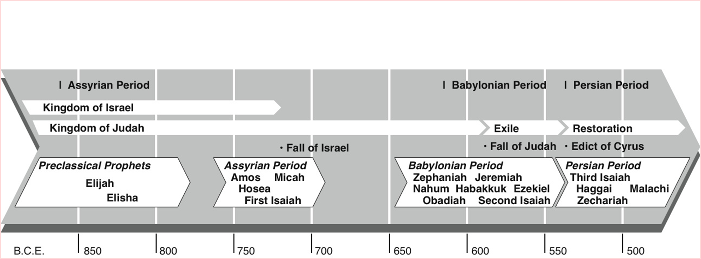

Slide 5
Who Is Haggai?
A Prophet
Name means “festive”
Unique as there is no one else with his name in scripture
Probably born in exile in Babylon
First of 3 prophets to remnant after return from Babylon.
(Haggai, Zechariah, Malachi)

Slide 6
Who is the Audience?
Small Jewish remnant returned from Babylon to Jerusalem 537-520 BC
Returned to a decimated Jerusalem
First the remnant was filled with joy and appreciation concerning the goodness of God
Quickly this sentiment waned and in it’s place lethargy and neglect for the House of God prevailed

Slide 7
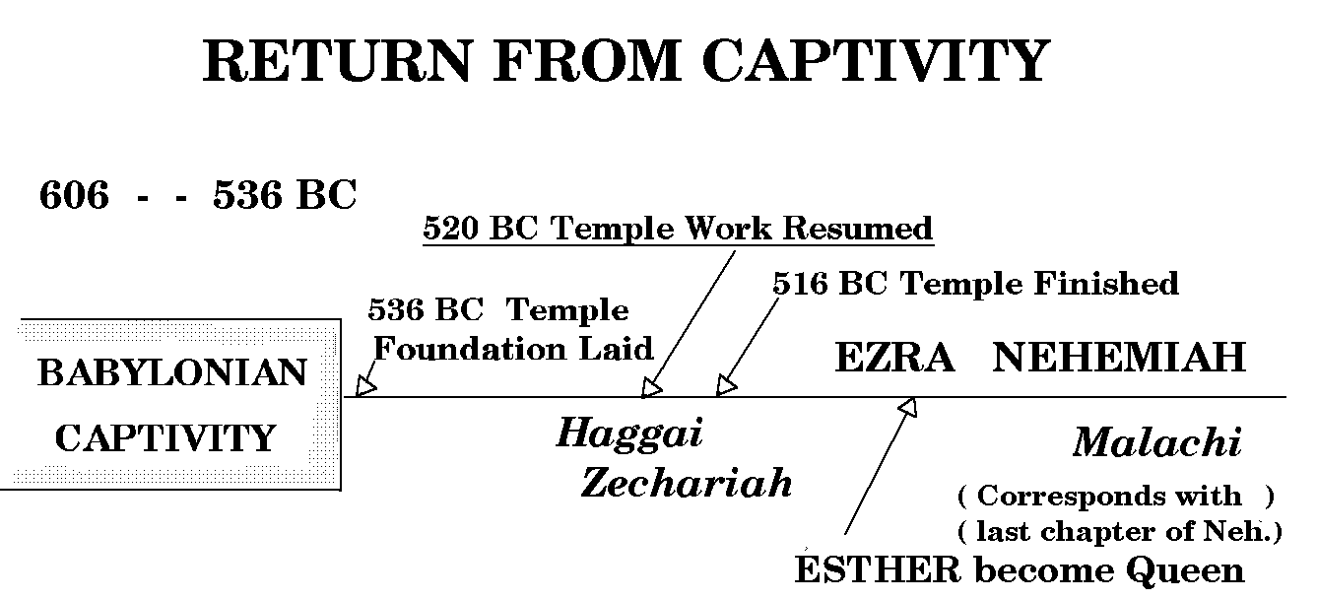

Slide 8
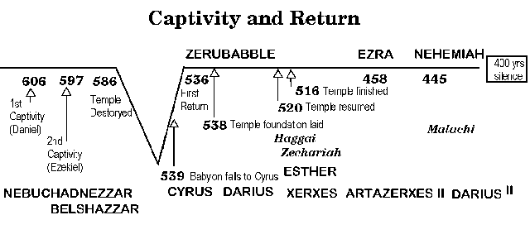

Slide 9
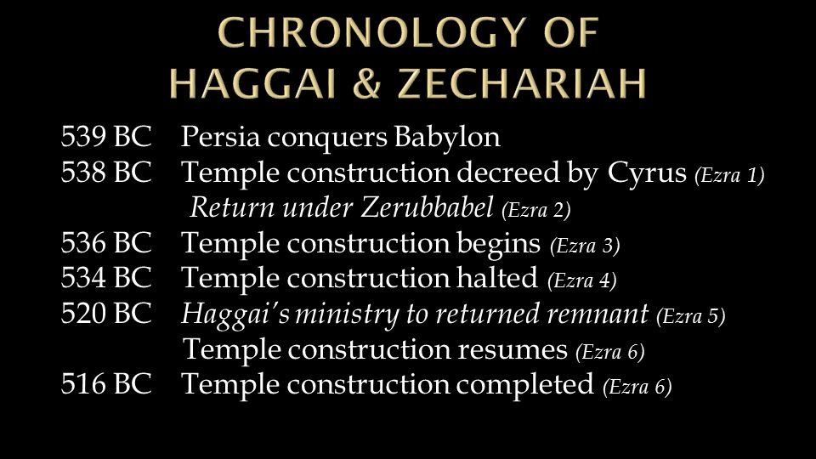

Slide 10
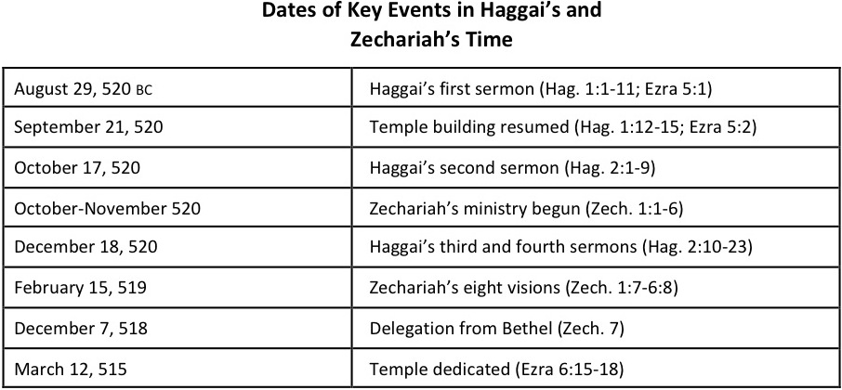

Slide 11
Purpose of Haggai
Encourage people to rebuild the temple
Urge and exhort people negligent in God’s work who had allowed natural things to have priority over spiritual.

Slide 12
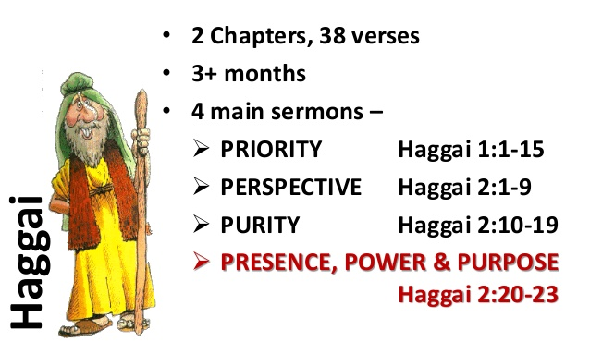
Overview of Haggai

Slide 13
Outline
Message One: The Call to Rebuild the Temple (1:1-15)
A. The Prophet’s Exhortation to Reorder Priorities (1:1-11)
B. The People’s Response of Renewed Priorities (1:12-15)
Message Two: The Call to Renewed Perspective (2:1-9)
A. The Discouragement of Comparison (2:1-3)
B. The Encouragement of God (2:4-9)
Message Three: The Call For Spiritual Purity (2:10-19)
A. The Need For Purity (2:10-14)
B. The Discipline for Impurity (2:15-17)
C. The Promise of Blessing (2:18-19)
Message Four: The Hope of a Messianic Promise (2:20-23)
A. The Coming of the Messianic Age (2:20-22)
B. The Coming of the Messianic King (2:23)
Taken from The Moody Bible Commentary, p. 1406

Slide 14
The Message

Slide 15
1st PROPHECY
(1st day of the 6th month)
Rebuke for neglect in rebuilding the temple (1:1-4)
Failure to rebuild resulted in scarcity and drought (1:5-11)
People encourage, obeyed, appreciated the person of the Lord and resumed work on Temple (1:12-15)

Slide 16
2nd PROPHECY
(21st day of the 7th month)
Haggai encourages people with the Lord’s presence (2:1-5)
Glory of the future temple would exceed the past (2:6-9)

Slide 17
3rd PROPHECY
(24th day of the 9th month)
Sacrifices unclean as long as Temple in ruins (2:10-14)
When people failed to lay foundation of Temple they suffered scarcity (2:15-17)
If they would resume work on the temple, the Lord would bless (2:18-19)

Slide 18
4th PROPHECY
(24th day of the 9th month)
God encourages his people with promise to overthrow gentile kingdoms.
He will establish messianic rule.
God’s promise to Zerubbabel as the signet ring.

Slide 19
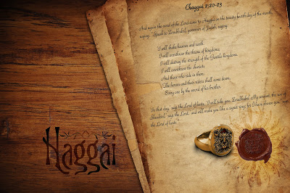
Signet Ring

Slide 20
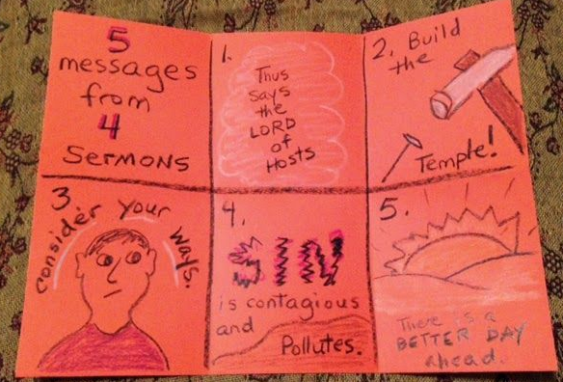
For Younger Minds in
Sunday School

Slide 21
Summary of 4 Prophecies
1st Prophecy-Rebuke and Repent
2nd Prophesy-Encourage and Exhort
3rd Prophesy-Blight and Blessing
4th Prophesy-Establish Messiah’s Reign

Slide 22
Practical Pointers
Forth telling (Concern with the PRESENT)-Consider your ways, obey, rebuild, rejoice
Foretelling(Concern with the FUTURE)-I am about to shake the nations

Slide 23
Practical Pointers
Application to Individual Believers- Will only enjoy God’s blessing when you put the Lord first in your life. (Matt: 6:33)
Application for the Local Assembly- Build the House of God that I may take pleasure in it and that I may be glorified. I am with you. My Spirit remains in your midst. Fear not. (Matt. 18:20)

Slide 24
Key Expressions
“Thus says the Lord”-26 times
“Consider your ways”
“I am with you” says the Lord
Be Strong
Lord of Hosts

Slide 25
Key Verses
Haggai 1:8 Build the house, that I may take pleasure in it and that I may be glorified, says the Lord.
Haggai 1:13-14 Then Haggai, the messenger of the Lord, spoke to the people with the Lord's message, “I am with you, declares the Lord.” And the Lord stirred up the spirit of the people.”
Haggai 2:4 Be strong, all you people of the land, declares the Lord. Work, for I am with you, declares the Lord of hosts.
Haggai 2:5 My Spirit remains in your midst. Fear not.

Slide 26

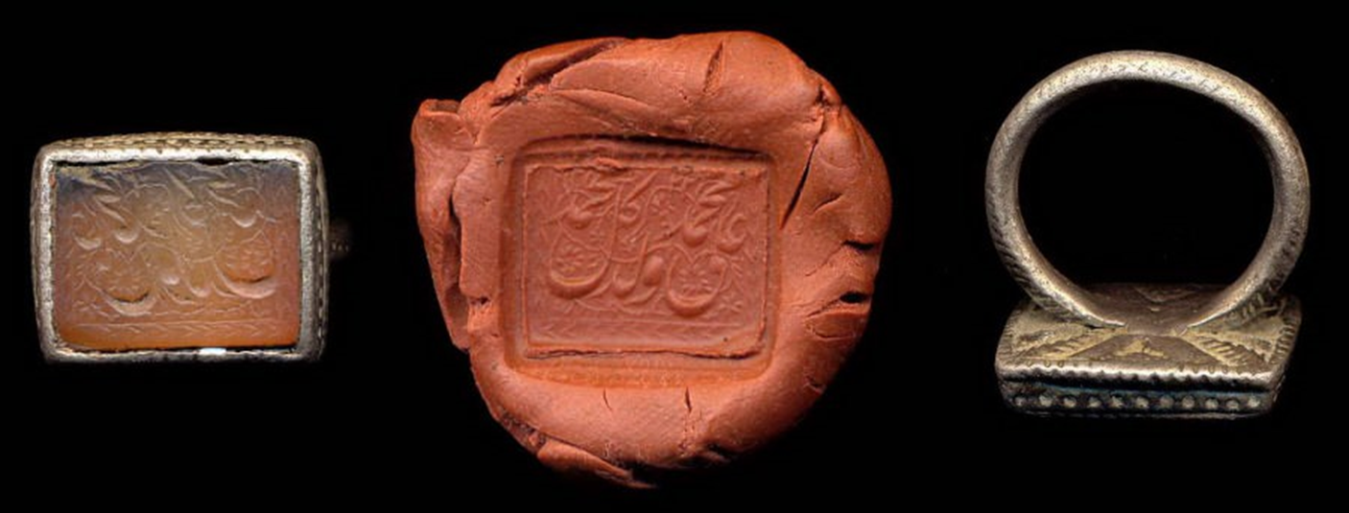
Pictures And Prophesies Of Christ
Haggai 2:7-9- Messiah will return and rule on Earth
Haggai 2:21-23- Zerubbabel as a signet ring is a picture of Christ during
the millennial reign on Earth

Slide 27
Malachi
Scott Yaekle

Slide 28


Slide 29
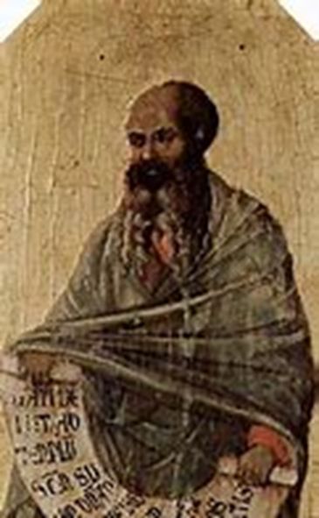
Who Is Malachi?
Name means “My Messenger”= Messenger of Jehovah
Tradition- member of great synagogue like Haggai and Zechariah
Last word from God to His people, 400 years until John the Baptist

Slide 30
Who was Malachi Speaking to?
Jewish people in Jerusalem, Remnant returned from Babylon 450-400BC
Nehemiah returns 445 BC under Artaxerxes (20th year)
Nehemiah executes most of what Malachi taught about intermarriage and honor to God.
Material support for the temple
Priests teaching the truth
Dialectic style-question and answer format in forceful prose

Slide 31
Historical Context

Slide 32
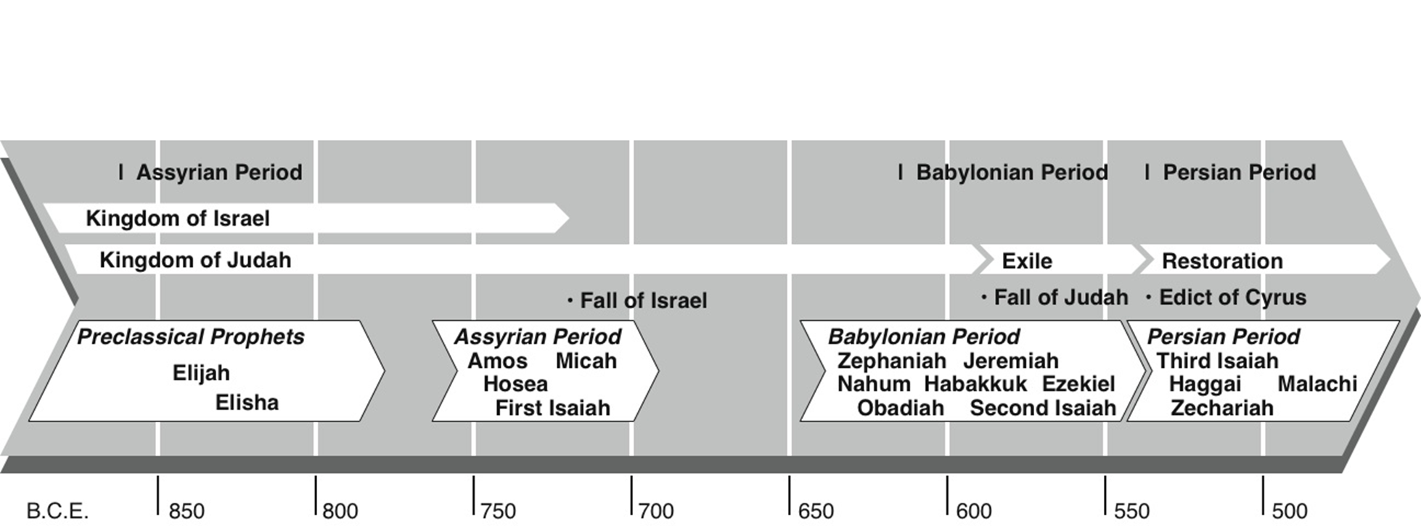

Slide 33
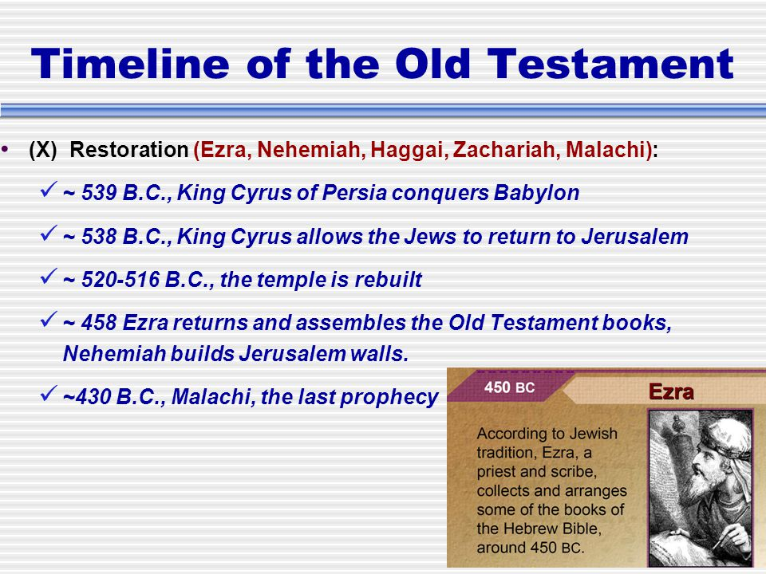

Slide 34
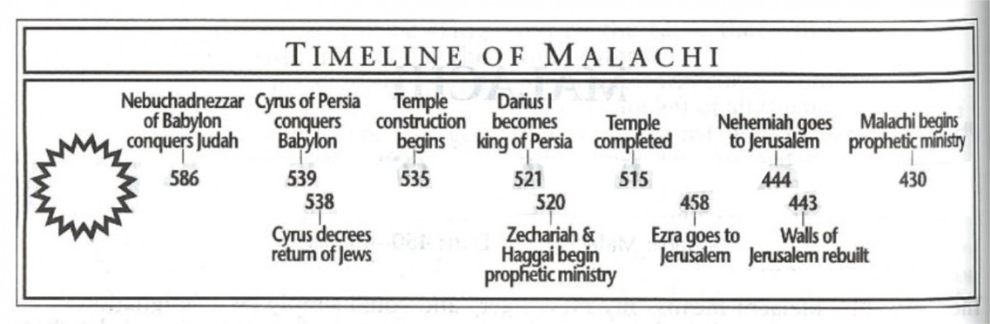

Slide 35
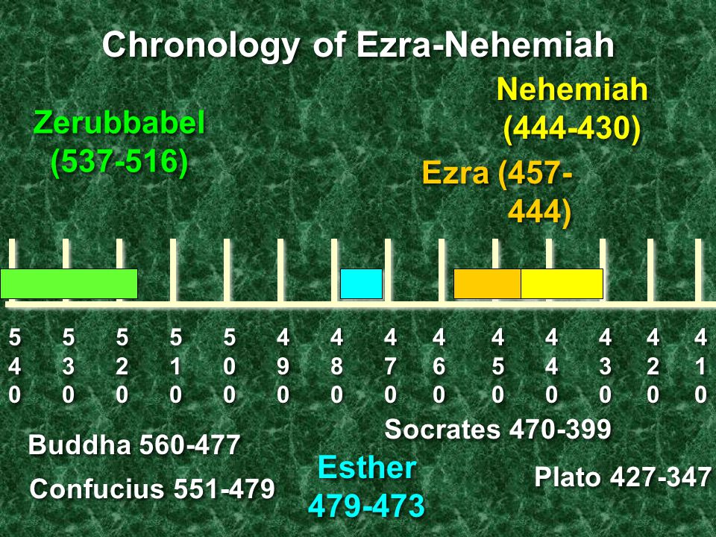

Slide 36
OUTLINE
Taken from Believer’s Bible Commentary, William McDonald p. 1174

Slide 37
8 FOLD CONTROVERSY OF LORD WITH HIS PEOPLE
(Another Way to View Malachi)
Mal. 1:2 “I have loved you,” says the Lord. But you say, “How have you loved us?”
Mal. 1:6 “A son honors his father/ servant fears master.” Where is my honor/fear? “How have we despised your name?”
Mal. 1:7 …polluted food upon my altar. But you say, “How have we polluted you?”
Mal. 2:14 “Why does He not show favor?” The Lord was witness to marriage and the wife of your youth, to whom you have been faithless.
Mal. 2:17 You have wearied the Lord with your words. But you say, “How have we wearied him?”
Mal. 3:7 “Return to me, and I will return to you”, says the Lord of hosts. But you say, ”How shall we return?”
Mal. 3:8 “Will man rob God?” Yet you are robbing me. But you say, ‘How have we robbed you?’
Mal. 3:13 “Your words have been hard against me”, says the Lord. But you say, ‘How have we spoken against you?’

Slide 38
The Main Message
God’s love for Israel (His people) and directs them to behave in the light of God’s love

Slide 39
The Message-Historical Purpose
Bring about spiritual revival in His day
Rectify moral and spiritual departure from divine revelation
Stern vigor reproved nation yet in tenderness he appealed to people to repent and return to the Lord.

Slide 40
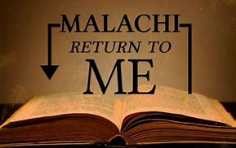

Slide 41
The Message-Prophetic Purpose
Teaches time of mercy (coming of forerunner) precedes the day of Lord-God’s Wrath
Warn people that the Lord (refiner) will purge away dross
Encourage people that Lord will come as Sun of Righteousness in judgement yet with healing in wings.

Slide 42
The Message-Practical Purpose
Unfold the unchanging character of God and His claims on His chosen people
Emphasize authority of divine revelation (Word of God) committed to His people
Underline abiding principles that should affect lives of the people of God in every age

Slide 43
Practical Pointers
God loves his people
God does not change-immutability-attribute of God
Responsibility of the Priest
  Guard knowledge
  Instruct the people
  Show no partiality
Faithful in marriage
Tithing
God remembers those who fear Him
Approach life/service to God with the end in view that HE IS COMING AGAIN!

Slide 44
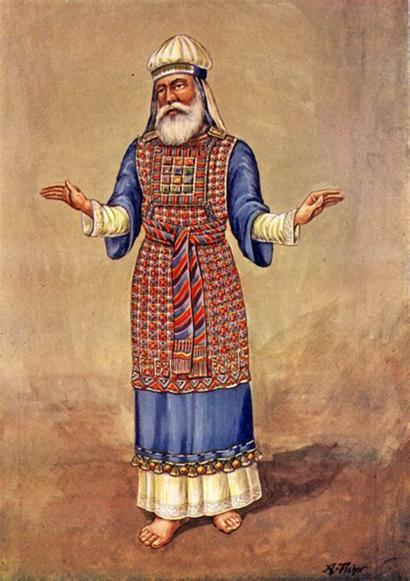
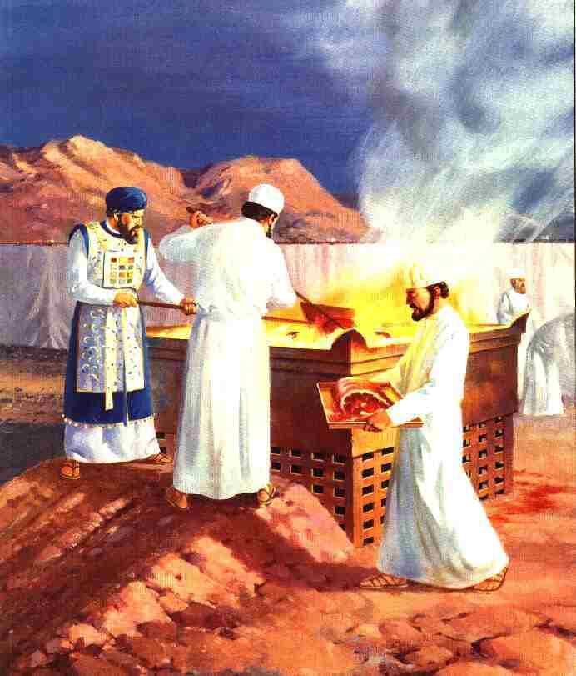
Priests

Slide 45
Key Verses
Malachi 1:2 “I have loved you,” says the Lord.
Malachi 3:6 “For I the Lord do not change”
Malachi 4:2 “But for you who fear my name, the sun of righteousness shall rise with healing in its wings.”

Slide 46
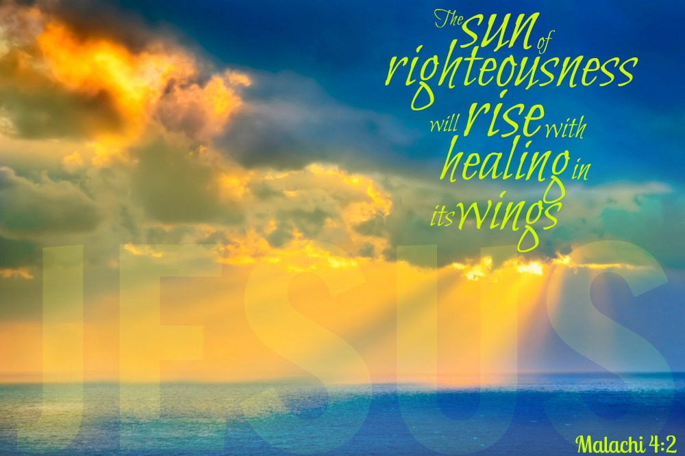

Slide 47
Pictures and Prophecies of Christ
Malachi 4:1 Day of the Lord Coming
Malachi 4:2 Healing in his wings
Malachi 3:1 Messenger of Covenant Coming (Behold He is Coming!)
Malachi 4:5 Elijah will come before great and awesome day of Lord. Nation (remnant) will repent or face wrath. Great Tribulation.

Slide 48
