Slide 1
Isaiah
Joel Joyce

Slide 2
Isaiah, The Prince of OT Prophets
“Isaiah is the great messianic prophet and prince of OT seers. For splendor of diction, brilliance of imagery, versatility and beauty of style and breadth of prophetic vision, he is without peer.”
M.F. Unger

Slide 3
Historical Context

Slide 4
The Setting
¹ The vision of Isaiah the son of Amoz, which he saw concerning Judah and Jerusalem in the days of Uzziah, Jotham, Ahaz, and Hezekiah, kings of Judah. Isaiah 1:1

Slide 5
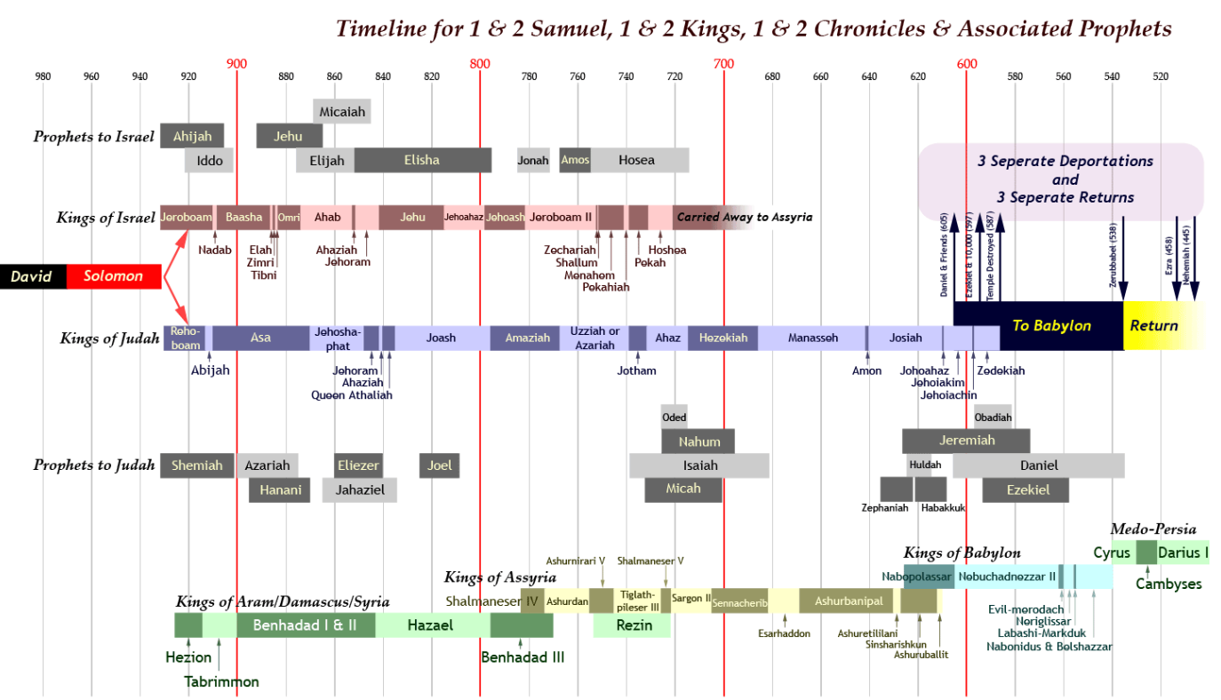
X
https://i0.wp.com/www.digitalc3.com/wp-content/uploads/2011/10/OT_Timeline-David-Zer_View.png

Slide 6
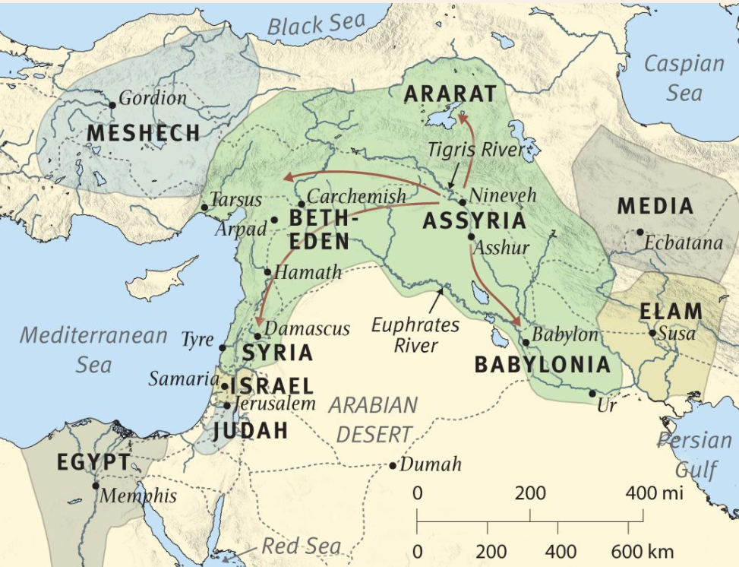
Threats and Temptations
Time of Isaiah
Dominant Threat
Assyria
Secondary Threats
Syria and the Northern Kingdom
Temptations for misplaced trust –alliances
Assyria
Syria and Northern Kingdom
Egypt
Babylon
Surrounding nations
Map from Global Bible Study Notes –Olive Tree

Slide 7
Kings and Conditions
Uzziah
790-739
Jotham
750-732
Ahaz
735-715
Manasseh
Hezekiah
716-686
Economic &
Military Power
Spiritual
Condition
Assyrian
Threat
Isaiah’s Ministry

Slide 8
Outline

Slide 9
1-66 Judgment & Hope (comfort, salvation, restoration, deliverance, blessing)
1-39 Judgment & Hope
40-66 Hope & Judgment
1-12 Judgment & Hope for Judah and Jerusalem
13-27 Judgment & Hope for the Nations
28-35 Judgment and Hope.
Warning against alliances
36-39
Historical Interlude –Hezekiah & Assyria
40-48
The LORD’s Supremacy
42-53
The LORD’s Servant
54-66
Salvation and Future Glory
Pre-exile standpoint
Post-exile Standpoint
Judgment
Hope
Judgment
Hope
Judgment
Hope
Judgment
Hope
Judgment
Hope
Judgment
Hope
Judgment
Hope
Judgment
Hope
Judgment
Hope
Judgment
Hope
Judgment
Hope
Judgment
Hope
Judgment
Hope
Judgment
Hope

Slide 10
Character Sketch

Slide 11
Isaiah the Man
Isaiah’s name means, ‘Yahweh is salvation’
Married to a prophetess and had two sons
Isaiah and his sons are signs in Israel, 8:18
A man of status as he had access to two kings
Ahaz –Isaiah sent to him
Hezekiah –sent for Isaiah

Slide 12
Isaiah’s Call –Isaiah 6
A Vision of the Glory of the LORD
Awareness of his own sinfulness, and that of the people
Atonement received
A willingness to be sent

Slide 13
Isaiah the Author
Sceptics: multiple authors
Argument
Wrote about future events –Babylon captivity and the return
Named Cyrus who lived over 150 years later
Different writing styles and vocabulary in different sections
Rebuttal
Wrote by inspiration of the God who knows and controls the future
Ignores common themes and vocabulary
Dead Sea Scrolls and Septuagint assume one Isaiah
NT writers (including Christ) reference Isaiah by name 22 times quoting from all parts of the book and assume one Isaiah

Slide 14
The Message

Slide 15
Backdrop -Israel's Covenants
Abrahamic Covenant
Unconditional, Everlasting
Land, Great Nation, Blessing
Sinai Covenant
Conditional
Blessing for obedience, cursing for disobedience
Davidic Covenant
Unconditional
Everlasting dynasty for the house of David
New Covenant
Unconditional
Forgiveness, new birth, pouring out of the Spirit

Slide 16
Backdrop of Israel’s Covenants
Basis for judgment
Call to obedience
Siani Covenant
Abrahamic Covenant
Davidic Covenant
Basis for the promise of Hope
New Covenant

Slide 17
The Glory of God
⁸ I am the Lord; that is my name; my glory I give to no other, nor my praise to carved idols. 42:8
“Holy One of Israel”
30 times in OT
25 times in Isaiah

Slide 18
The Glory of God
For thus says the LORD, who created the heavens (he is God!), …“I am the LORD, and there is no other. 45:18
Only Creator

Slide 19
The Glory of God
¹⁵ Behold, the nations are like a drop from a bucket, and are accounted as the dust on the scales….40:15
¹⁸ To whom then will you liken God, or what likeness compare with him? 40:18
²³ who brings princes to nothing, and makes the rulers of the earth as emptiness. 40:23
Only Creator
Only Sovereign

Slide 20
The Glory of God
Only Creator
Woe to, Assyria, the rod of my anger; the staff in their hands is my fury! ⁶ Against a godless nation I send him, and against the people of my wrath I command him, to take spoil and seize plunder…. 10:5-6
Only Sovereign

Slide 21
The Glory of God
⁸ I am the Lord; that is my name; my glory I give to no other, nor my praise to carved idols. ⁹ Behold, the former things have come to pass, and new things I now declare; before they spring forth I tell you of them.” 42:8-9
Only Creator
Only Sovereign
Only One Who Knows the Future
and Brings it to Pass

Slide 22
The Glory of God
⁹ …I am God, and there is no other; I am God, and there is none like me,
¹⁰ declaring the end from the beginning and from ancient times things not yet done, saying, My counsel shall stand, and I will accomplish all my purpose,’
¹¹ ….I have spoken, and I will bring it to pass; I have purposed, and I will do it. 46:9-11
Only Creator
Only Sovereign
Only One Who Knows the Future
and Brings it to Pass

Slide 23
The Glory of God
¹¹ I, I am the Lord, and besides me there is no savior. 43:11
²¹…there is no other god besides me, a righteous God and a Savior; there is none besides me.
²² “Turn to me and be saved, all the ends of the earth! For I am God, and there is no other. 45:21b-22
Only Creator
Only Sovereign
Only One Who Knows the Future
and Brings it to Pass
Only Savior

Slide 24
Judgment
Indictments
Consequences

Slide 25
Judgment -Indictments
¹² …O my people, your guides mislead you …. 3:12
¹⁵ What do you mean by crushing my people, by grinding the face of the poor?” 3:15
¹⁰ His watchmen are blind; they are all without knowledge; they are all silent dogs; they cannot bark, dreaming, lying down, loving to slumber. 56:10
¹¹…. But they are shepherds who have no understanding; they have all turned to their own way 56:11
Leaders –Injustice, Oppression

Slide 26
Judgment -Indictments
​¹ “Ah, stubborn children,” declares the Lord, “who carry out a plan, but not mine, and who make an alliance, but not of my Spirit, that they may add sin to sin; 30:1
² who set out to go down to Egypt, without asking for my direction, to take refuge in the protection of Pharaoh and to seek shelter in the shadow of Egypt! 30:2
¹ Woe to those who go down to Egypt for help and rely on horses, who trust in chariots …but do not look to the Holy One of Israel or consult the Lord! 31:1
Leaders –Injustice, Oppression
Forming Alliances

Slide 27
Judgment -Indictments
“What to me is the multitude of your sacrifices? says the LORD; I have had enough of burnt offerings …. I do not delight in the blood of bulls, or of lambs, or of goats. (12) “When you come to appear before me, who has required of you this trampling of my courts? 1:11-12
…this people draw near with their mouth and honor me with their lips, while their hearts are far from me… Isa 29:13
…. Behold, in the day of your fast you seek your own pleasure, and oppress all your workers. 58:3
Leaders –Injustice, Oppression
Forming Alliances
Formalism and Corrupted Worship

Slide 28
Judgment -Indictments
Rise up, you women who are at ease, hear my voice; you complacent daughters, give ear to my speech. 32:9
Tremble, you women who are at ease…. 32:11
The haughty looks of man shall be brought low, and the lofty pride of men shall be humbled, and the LORD alone will be exalted in that day. 2:11
Leaders –Injustice, Oppression
Forming Alliances
Formalism and Corrupted Worship
Pride and Complacency

Slide 29
Judgment -Indictments
Woe to those who call evil good and good evil, who put darkness for light and light for darkness, who put bitter for sweet and sweet for bitter! 5:20
Justice is turned back, and righteousness stands far away; for truth has stumbled in the public squares, and uprightness cannot enter. 59:14
Truth is lacking, and he who departs from evil makes himself a prey.… 59:15
Leaders –Injustice, Oppression
Forming Alliances
Formalism and Corrupted Worship
Pride and Complacency
Contempt for Truth

Slide 30
Judgment -Indictments
For they are a rebellious people… unwilling to hear the instruction of the LORD;
who say …to the prophets, “Do not prophesy to us what is right; speak to us smooth things, prophesy illusions,
…let us hear no more about the Holy One of Israel.” 30:9-11
Leaders –Injustice, Oppression
Forming Alliances
Formalism and Corrupted Worship
Pride and Complacency
Contempt for Truth

Slide 31
Judgment -Consequences
Judicial Blindness
Isa 6:9-10; 29:9-14; 44:18; 63:17
Foreign Threats and Loss of Independence
Isa 1:7, 8:7 9:8-12
Exile and Dispersion
Isa 5:13; 11:12; 22:17-18; 56:8
Hardship, Frustration, Decline
Isa 4:18-26; 5:5-6,9-10, 15; 9:20-21

Slide 32
Judgment and Its Effects -Purification
I will turn my hand against you and will smelt away your dross as with lye and remove all your alloy. 1:25
When the Lord shall have washed away the filth of the daughters of Zion and cleansed the bloodstains of Jerusalem from its midst by a spirit of judgment and by a spirit of burning. 4:4

Slide 33
Hope
Near Hope
Return from Babylon captivity -6th Century BC
Far Hope –still future
Israel redeemed, regathered, and reigning when Christ returns to earth and sets up His kingdom
Covenants fulfilled -Abrahamic, Davidic, New Covenant
New Heavens and the New Earth –the eternal state

Slide 34
Hope
But he was pierced for our transgressions; he was crushed for our iniquities; upon him was the chastisement that brought us peace, and with his wounds we are healed. 53:5
Substitution

Slide 35
Hope
In that day the Lord will extend his hand yet a second time to recover the remnant that remains of his people, from Assyria, from Egypt, from Pathros, from Cush, from Elam, from Shinar, from Hamath, and from the coastlands of the sea. (12) He will raise a signal for the nations and will assemble the banished of Israel, and gather the dispersed of Judah from the four corners of the earth. 11:11-12
Substitution
Regathering

Slide 36
Hope
…I will pour my Spirit upon your offspring, and my blessing on your descendants. 44:3
One will say, ‘I am the LORD's…and another will write on his hand, ‘The LORD's….44:5
All your children shall be taught by the LORD, and great shall be the peace of your children. 54:13
“Listen to me, you who know righteousness, the people in whose heart is my law…. 51:7
“I, I am he who blots out your transgressions for my own sake, and I will not remember your sins. 43:25
Substitution
Regathering
Regeneration (New Covenant)

Slide 37
Hope
Then the eyes of the blind shall be opened, and the ears of the deaf unstopped; (6) then shall the lame man leap like a deer, and the tongue of the mute sing for joy. 35:5-7
For waters break forth in the wilderness, and streams in the desert; (7) the burning sand shall become a pool, and the thirsty ground springs of water; in the haunt of jackals, where they lie down, the grass shall become reeds and rushes.
The wolf shall dwell with the lamb, and the leopard shall lie down with the young goat, and the calf and the lion and the fattened calf together; and a little child shall lead them. 11:6
Substitution
Regathering
Regeneration (New Covenant)
Rejuvenation

Slide 38
Hope
Behold, a king will reign in righteousness, and princes will rule in justice. 32:1
He [Christ] shall judge between the nations, and shall decide disputes for many peoples…2:4a
…they shall beat their swords into plowshares, and their spears into pruning hooks; nation shall not lift up sword against nation, neither shall they learn war anymore. 2:4b
Substitution
Regathering
Regeneration (New Covenant)
Rejuvenation

Slide 39
Hope
(2) It shall come to pass in the latter days that the mountain of the house of the LORD shall be established as the highest of the mountains, and shall be lifted up above the hills; and all the nations shall flow to it,
(3) and many peoples shall come, and say: “Come, let us go up to the mountain of the LORD, to the house of the God of Jacob, that he may teach us his ways and that we may walk in his paths.” For out of Zion shall go forth the law, and the word of the LORD from Jerusalem. 2:2-3
Substitution
Regathering
Regeneration (New Covenant)
Rejuvenation
Glorification

Slide 40
Hope
And nations shall come to your light, and kings to the brightness of your rising. 60:3
Then you shall see and be radiant…the wealth of the nations shall come to you. 60:5
Foreigners shall build up your walls, and their kings shall minister to you….60:10
The sons of those who afflicted you shall come bending low to you, and all who despised you shall bow down at your feet…. 60:14
…but you shall be called the priests of the LORD; they shall speak of you as the ministers of our God…61:6
Substitution
Regathering
Regeneration (New Covenant)
Rejuvenation
Glorification

Slide 41
Hope
“For behold, I create new heavens and a new earth, and the former things shall not be remembered or come into mind. 65:17
The sun shall be no more your light by day, nor for brightness shall the moon give you light; but the LORD will be your everlasting light, and your God will be your glory. 60:19
Your sun shall no more go down, nor your moon withdraw itself; for the LORD will be your everlasting light, and your days of mourning shall be ended. 60:20)
Substitution
Regathering
Regeneration (New Covenant)
Rejuvenation
Glorification

Slide 42
Pictures and Prophecies of Christ

Slide 43
Messianic Prophecies –Already Fulfilled
He will be called before His birth to be God’s Servant (49:1)
He will be born of a virgin, (7:14)
He will be a Descendent of David and thus in the Davidic line (11:1,10)
He will be empowered by the Holy Spirit, (11:2; 42:1)
He will be gentle toward the weak (42:3)
He will be obedient to the Lord in his mission (50:4-9)
He will voluntarily submit to suffering (50:6; 53:7-9)
He will be rejected by Israel (49:7; 53:1,3)
He will take on himself the sins of the world (53:4-6, 10-12)
He will triumph over death (53:10)
He will be exulted (52:13; 53:12)
The Bible Knowledge Commentary p1049

Slide 44
Messianic Prophecies –To Be Fulfilled
He will come to comfort Israel and to bring vengeance on the wicked (61:1-3)
He will manifest God’s glory (49:23)
He will restore Israel spiritually to God (49:5) and physically to the land (49:8)
He will reign on David’s throne (9:7)
He will bring joy to Israel (9:2)
He will make a new covenant with Israel (42:6; 49:8-9)
He will be a light to the Gentiles (42:6; 49:6)
He will restore the nations (11:10)
He will be worshipped by Gentiles (49:7; 52:15)
He will govern the world (9:6)
He will judge in righteousness, justice, and faithfulness (11:3-5; 42:1,4)
The Bible Knowledge Commentary p1049

Slide 45
Key Verse?
He will swallow up death forever; and the Lord GOD will wipe away tears from all faces, and the reproach of his people he will take away from all the earth, for the LORD has spoken. (Isa 25:8)
It will be said on that day, “Behold, this is our God; we have waited for him, that he might save us. This is the LORD; we have waited for him; let us be glad and rejoice in his salvation.” (Isa 25:9)

