Slide 1
Zechariah
Doug Mason

Slide 2
Historical Background

Slide 3
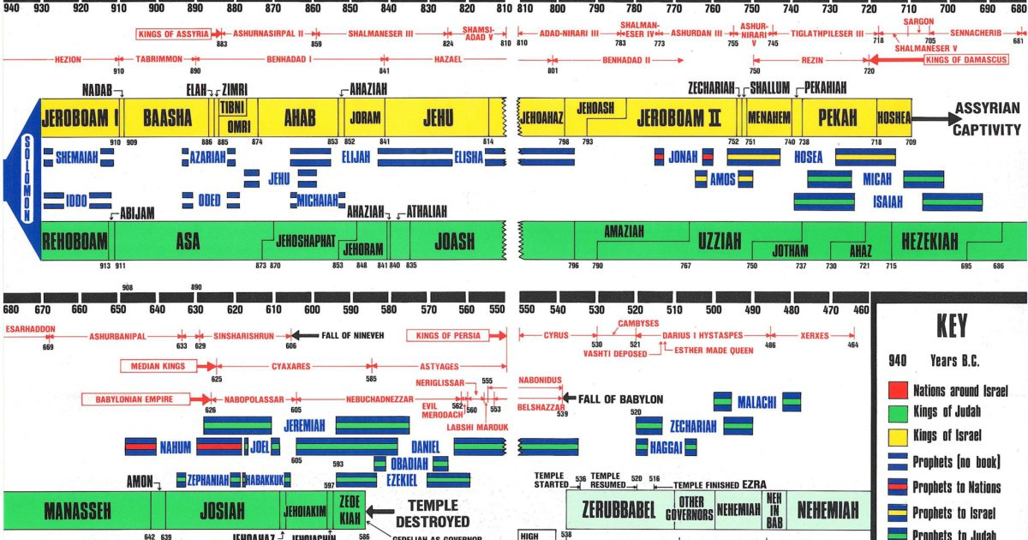

Slide 4
Time of Zechariah

Slide 5
God’s Charge / Man’s Opposition
“Thus says Cyrus king of Persia: The Lord, the God of heaven, has given me all the kingdoms of the earth, and he has charged me to build him a house at Jerusalem, which is in Judah. Whoever is among you of all his people, may his God be with him, and let him go up to Jerusalem, which is in Judah, and rebuild the house of the Lord, the God of Israel—he is the God who is in Jerusalem.
Artaxerxes - Therefore make a decree that these men be made to cease, and that this city be not rebuilt, until a decree is made by me. … Then the work on the house of God that is in Jerusalem stopped

Slide 6
A Word From The Lord Of Hosts The word of the Lord came to the prophet Zechariah
Haggai 1:4 “Is it a time for you yourselves to dwell in your paneled houses, while this house lies in ruins?
Ezra 5:1 -…Zechariah the son of Iddo, prophesied to the Jews …in the name of the God of Israel … Then Zerubbabel …began to rebuild the house of God that is in Jerusalem, …
Ezra 6:14 And the elders of the Jews built and prospered through the prophesying of Haggai the prophet and Zechariah the son of Iddo
Acts 5:29 We ought to obey God rather than men.

Slide 8
Who was Zechariah
A priest – Nehemiah 12:16
Son of Berechiah – Jehovah Blesses
Son of Iddo – The appointed time
Zechariah means– Jehovah remembers
He came up with Zerubbabel in the first return to Jerusalem
Quoted often in the New Testament
Direct quotes and allusions – some estimate 54 passages from Zechariah in 67 places in the New Testament
LORD of Hosts – 46x – Jehovah of that which goes forth (warfare)

Slide 9
Purpose of Zechariah

Slide 10
Purpose of Zechariah
A call to return to the Lord of Hosts (Current and Future)
1:3 Return to me, says the Lord of hosts, and I will return to you, says the Lord of hosts
2:7 Up! Escape to Zion, you who dwell with the daughter of Babylon.
8:7 I will save my people …, and I will bring them to dwell in the midst of Jerusalem.
9:12 Return to your stronghold, O prisoners of hope
10:8 I will whistle for them and gather them in
A call to build the dwelling place in the midst of His people
1:16 …I have returned to Jerusalem with mercy; my house shall be built in it
6:12 the Branch… he shall build the temple of the Lord.
8:9 Let your hands be strong, … that the temple might be built
14:21 …no longer be “one that defiles” in the house of the Lord of hosts on that day.

Slide 11
Themes in Zechariah
A constant call to return to the Lord of Hosts
The Lord will have a dwelling place among his people
The Lord of Hosts will judge what opposes and defiles
The Lord of Hosts will bring prosperity to his people
The Lord will be King over all the earth in That Day
1 Cor 1:9 God is faithful, by whom you were called into the fellowship of his Son, Jesus Christ our Lord.

Slide 12
Overview of Zechariah Call to return -1:1-1:6 Visions of Hope -1:7-6:17 Call to Holiness -7:1-8:23 Oracles of the Future -9:1-14:21

Slide 13
Chapters 1-6 Visions from the Lord of Hosts Nine in one night

Slide 14
The themes of the Visions of Zechariah For all the promises of God in him are yea, and in him Amen, unto the glory of God
I will return to Jerusalem and call my people to me
I will punish those that hinder my people
I will bring prosperity to the land
I will cleanse nationally
I will supply my Spirit to support you in my work
I will remove iniquity and false worship from the land
I will bring rest to the world and myself
I will set My righteous Branch to rule as Priest and King

Slide 15
The Man in the Myrtle trees And the Lord answered gracious and comforting words
Zechariah 1:7-17
The nations who scattered Israel are at rest
They overstepped their charter and will be judged
I am exceedingly jealous for Jerusalem and for Zion
I have returned to Jerusalem with mercy
My house shall be built in it
My cities shall again overflow with prosperity
The Lord will again comfort Zion and choose Jerusalem

Slide 16
Judgment of the Nations that Scattered Israel The Lord of Hosts is jealous for His people
Zechariah 1:18-21
Possible Nations
1 – Assyrians (Israel)
2 – Babylonian (Judah)
3 – Persians (Current)
4 – Greece (Zech 9:4)
Possible Nations (Daniel)
1 – Babylonia
2 – Medo-Persia
3 – Greece
4 – Rome

Slide 17
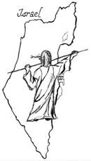
The Measuring of Jerusalem Promise of prosperity
Zechariah 2:1-13
Jerusalem will again prosper
The Lord will be the glory in her midst (3x)
Exhortation to return from Babylon
Many nations will join “in that day” (21x in book)
My cities shall again overflow with prosperity
The Lord will again choose Jerusalem

Slide 18
Joshua a Picture of Salvation a brand plucked from the fire
Zechariah 3:1-10
The High Priest representing the people in sin
Satan “the accuser” rebuked by The Lord
“I have taken your iniquity away from you”
The decision to walk in God’s way brings blessing
God’s servant “The Branch” promised
Iniquity removed from the land in a single day
“In that day” peace and prosperity
Zechariah’s impromptu request of a clean Turban

Slide 19
The Golden Lampstand Not by might, nor by power, but by my Spirit, says the Lord of Hosts
Zechariah 4:1-14
The Temple will be built by Zerubbabel
Shouts of Joy heard when cap stone placed
The Lord is working
Those who despised the day of small things will rejoice
The Two branches
They stand before the Lord of the whole earth

Slide 20
The Flying Scroll Personal judgment
Zechariah 5:1-4
The size of Solomon’s porch
Perhaps where the law was read
Two curses pronounced
Those who steal (sin against man)
Those who swear falsely (sin against God)
Cleanse the land
All that was built (home) consumed

Slide 21
Woman in the Basket Iniquity in all the land removed
Zechariah 5:5-11
All iniquity in the land captured in one place
Woman called “wickedness”
Idolatry in view? Babylon
It is removed from the land
Returned Shinar (Babylon)
God’s hand needed to remove sin
A place prepared for it
Placed on a base in a house built for it

Slide 22
The Four Chariots Rest brought to God’s Spirit on the earth
Zechariah 6:1-8
Sent to the four winds of Heaven
No comment on what they are doing
Chariots speak of war
Strong horses, impatient to patrol the earth
Eager to obey God and finish their work
Those from the north bring rest to God
The other’s will do the same

Slide 23
The Crown of Gold and Silver The Branch shall build the temple and rule
Zechariah 6:9-15
A crown of silver and gold set on Joshua
A priest crowned pictures Christ
The crown left in the Temple
The man whose name is “The Branch”
Will bear royal honor
Will be a priest on His throne
Will build the temple of the Lord of Hosts
This will come to pass if diligently obey the voice of the Lord

Slide 24
Would these visions have encouraged you to continue to build the Temple of God. It did these people!

Slide 25
Chapters 7-8 From fasting and sorrow to feasting and gladness

Slide 26
Chapter 7-8 A little Chiasm in the middle
A – 7:2 -Desire to entreat the favor of the Lord when “God was not with them”
B – 7:3 - Continue Fasting and weeping to show they were penitent
C – 7:11- Refused; true Judgments, kindness, mercy, goodness in their hearts
D – 7:14 - Great anger from the Lord of Hosts scattered them
E – 8: 3 - The Lord of Hosts to dwell in the midst of Jerusalem
D’ – 8:7 - Save His people and return them to Jerusalem
C’ – 8:16 - Must; have true judgments, speak truth, love no false oath, do good
B’ – 8:19 - Fasts will be turned to seasons of joy, gladness and cheerful feasts
A’ – 8:22-23 - The nations will seek the favor of the Lord of Hosts because “God is with you”
Key verse 8:19 – Therefore love truth and peace.

Slide 27
Chapters 9-14 The Return of the King

Slide 28
Chapter 9 First Oracle: The first and second coming of the Great Shepherd
9:1-8 - Judgment on surrounding nations
No oppressor shall march over his people again
9:9 – The meek and lowly King comes to Jerusalem
Fulfillment – John 12:14-15
9:10-17 – The salvation and rule of His people
Rule from sea to sea
Call for His people to return
“on that Day”
Save the flock of His people
How great is his goodness and his beauty

Slide 29
Chapter 10 First Oracle: The care of the Lord for His flock
10:1-3a – Anger at the shepherds of His people
Led into idolatry and will be punished
10:3b-12– The care of the Lord for His flock shown
Supplies the cornerstone, nail and battle bow
The whistle, a call to return
There will be no room for them
They shall walk in the name of the Lord

Slide 30
Chapter 11 First Oracle: Rejection of the Good Shepherd
11:1-3 Israel’s shepherds to be cut down
They will wail for their glory is ruined
11:4-14 Zechariah pictures the rejection of the Good Shepherd
They also detested me
They weighed out my wages thirty pieces of silver
So I took the thirty pieces of silver and threw them into the house of the Lord, to the potter.
Annulling of the two covenants Favor and Union
11:15-17 An idol shepherd raised up
No care for the sheep
Will devour them
Woe pronounced on the idol shepherd

Slide 31
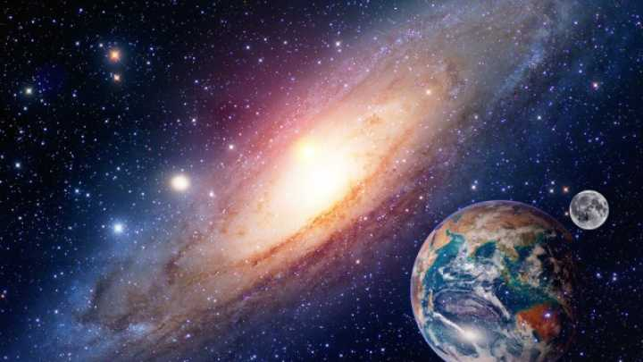
Chapter 12 - 14 Second Oracle: “On that Day”
The one who declares all that follows is the one
who stretched out the heavens
Who founded the earth
Who formed the spirit of man within him
HE is the LORD OF HOSTS

Slide 32
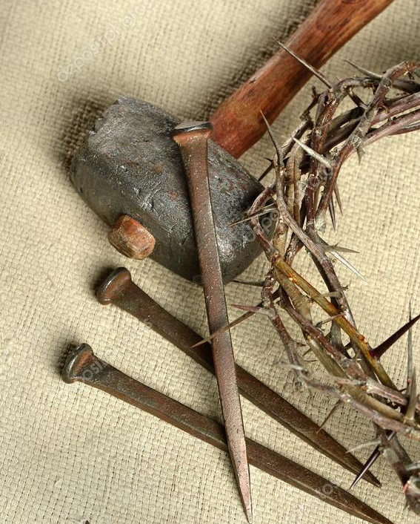
Chapter 12 - 14 Second Oracle: “On that Day”
Judgement on the nations who war against Jerusalem
Jerusalem a cup of staggering to all the surrounding peoples
The clans of Judah like a blazing pot in the midst of wood
“I will destroy all the nations that come against Israel
Salvation/Cleansing for House of David and Jerusalem
When they look on me, him whom they have pierced, they shall mourn for him
A fountain of cleansing opened for the house of David
Names of idols…spirit of uncleanness cut off from the land
The Shepherd struck and sheep scattered
The remnant refined and will say “The Lord is my God”

Slide 33
Chapter 12 - 14 Second Oracle: “On that Day”
Jerusalem Besieged – a unique day
I will gather all the nations against Jerusalem to battle
Horrible things take place in Jerusalem – half of the city goes into exile
The Lord returns to the Mount of Olives as promised
Then the Lord my God will come, and all the holy ones with him.
Terrible plague falls on all those who wage war on Jerusalem
Mt of Olives splits, living waters flow out of Jerusalem, Jerusalem is raised up
The Lord will be king over all the earth…the Lord will be one and his name one.
Then everyone who survives of all the nations … go up year after year to worship the King, the Lord of hosts, and to keep the Feast of Booths.

Slide 34
“Holy to the Lord.” On that day There shall no longer be ‘one who defiles’ in the house of the Lord of hosts.

Slide 35
Key Verse “Fear not, but let your hands be strong” Zechariah 8:13 Key Phrase – “on that day”

Slide 37
Prophecies fulfilled
Zech 9:9 - John 12:14-15 just as it is written, “Fear not, daughter of Zion; behold, your king is coming, sitting on a donkey's colt!”
Zech 11:12-13 – Matthew 27:9-10 Then was fulfilled what had been spoken by the prophet Jeremiah, saying, “And they took the thirty pieces of silver, the price of him on whom a price had been set by some of the sons of Israel, and they gave them for the potter's field, as the Lord directed me
Zech 12:10 – John 19:37 And again another Scripture says, “They will look on him whom they have pierced.”

