Slide 1
Jeremiah
David Vallance

Slide 2
Importance and Relevance
Longest book in the Bible by word count
Longest OT quotation in NT:
Jeremiah 31:31-34 in Hebrews 8:8-12
New Covenant in 31—cf. Luke 22:20, “This cup that is poured out for you is the new covenant in my blood.”
End-time ministry, the last 40 years of the Kingdom of Judah (626-586 BC)
Began in good times under worthy Josiah, and then evil times under wicked Jehoiakim and weak Zedekiah

Slide 3
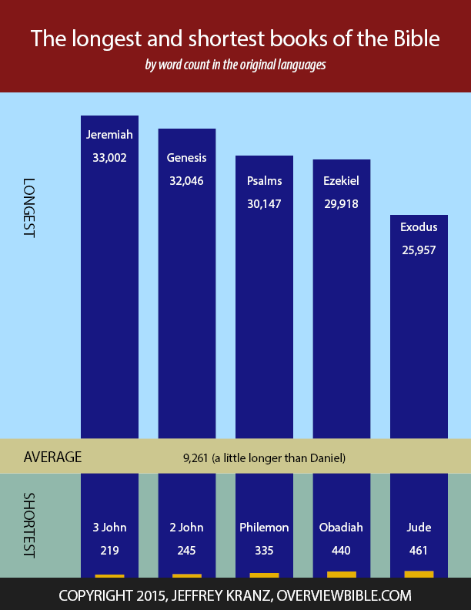

Slide 4
Historical Context

Slide 5
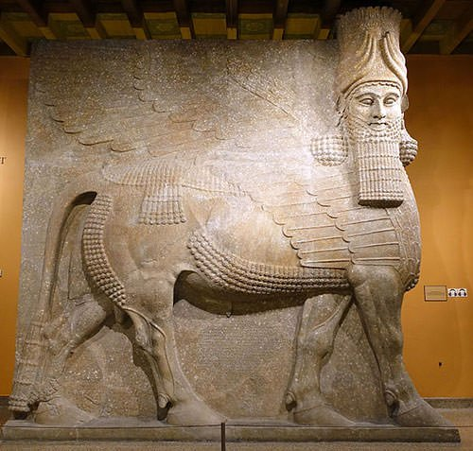
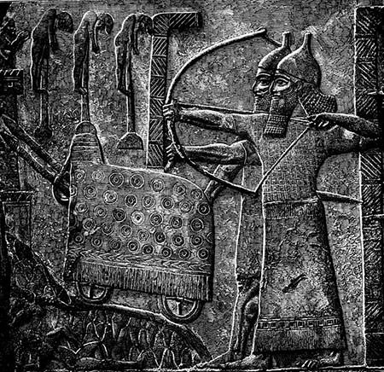
Assyria’s power was waning—Nineveh destroyed in 612 BC [40-Ton Lamassu / Relief of Tiglath-Pileser Besieging a City]

Slide 6
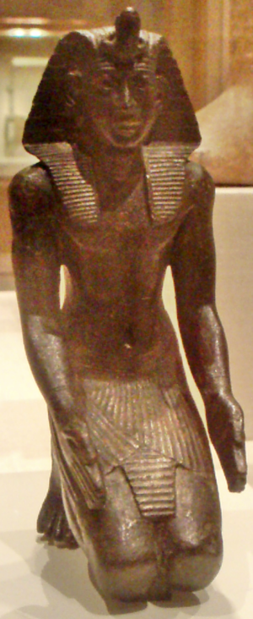
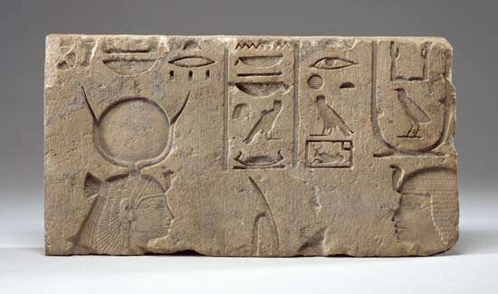
Egypt grew weaker—Necho II defeated at Carchemish in 605 BC [Necho II / On (right) facing the goddess Hathor, c. 600 BC]
Notes:
Egypt withdrew from the Levant, but continued to influence politics.

Slide 7
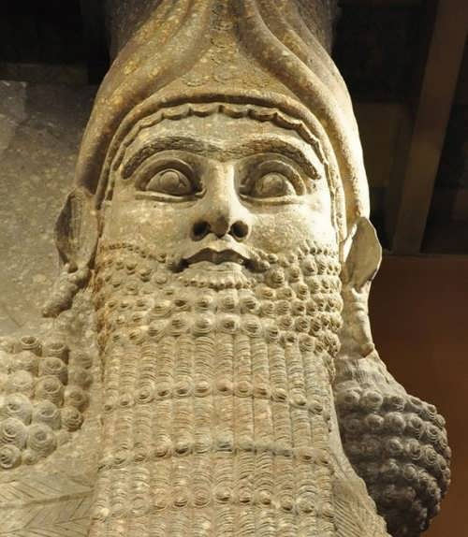
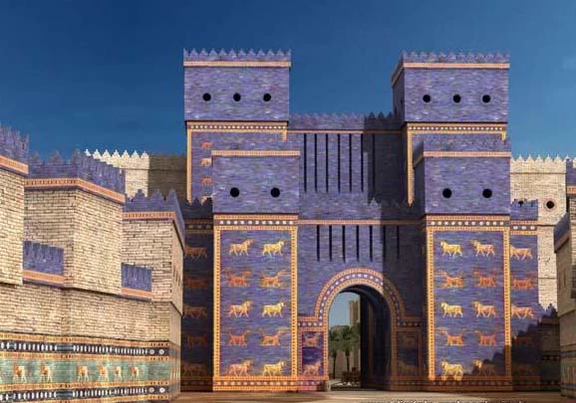
Neo-Babylonian empire was rising (626-539 BC) [Nebuchadnezzar II / Ishtar gate c. 575 BC]
Notes:
Jeremiah prophesied its emergence under Nabopolassar, its expansion under his son Nebuchadnezzar, and its end (which Daniel saw)

Slide 8
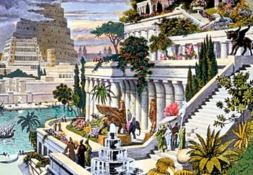
Hanging Gardens of Babylon
Notes:
Jeremiah prophesied its emergence under Nabopolassar, its expansion under his son Nebuchadnezzar, and its end (which Daniel saw)

Slide 10
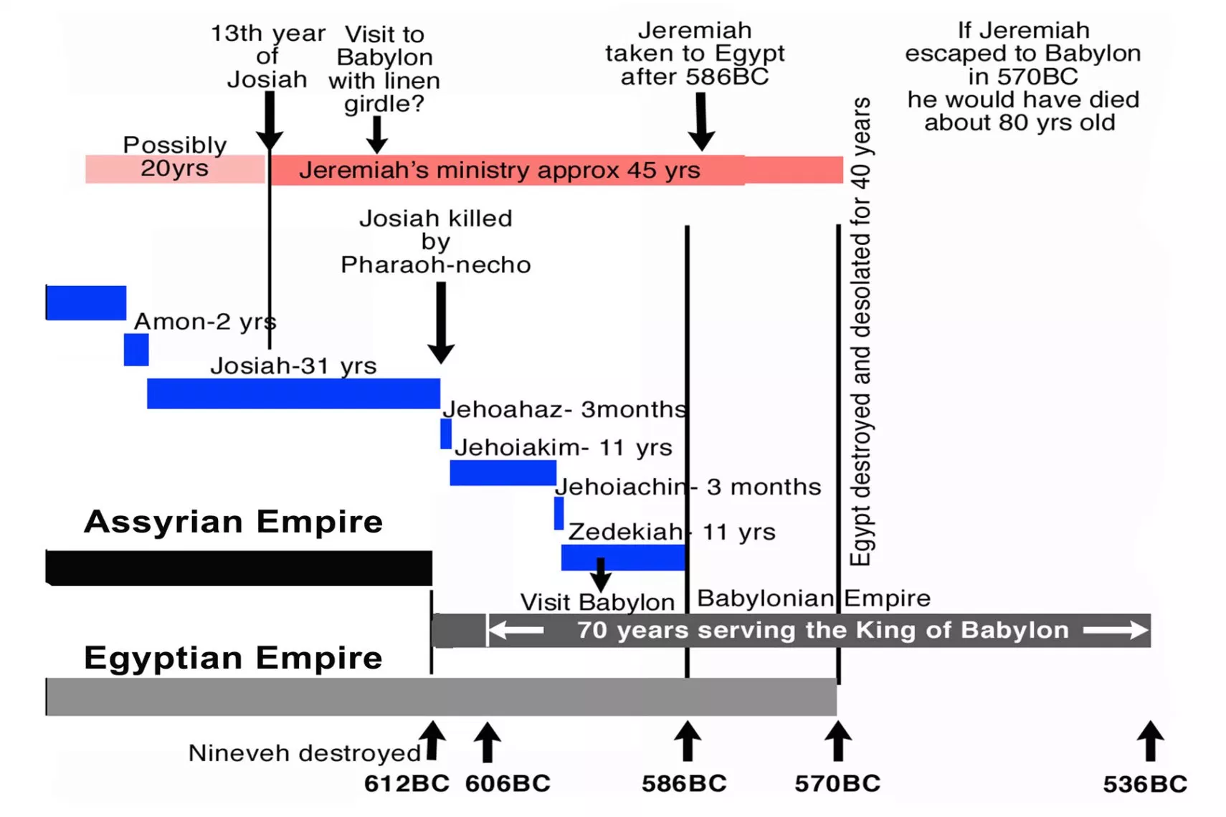

Slide 11
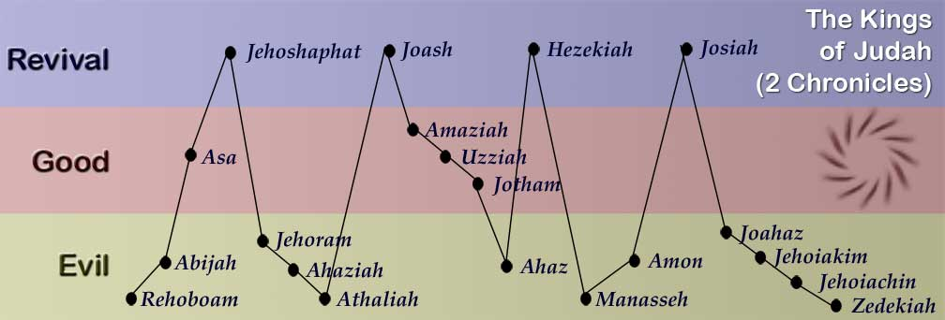

Slide 14
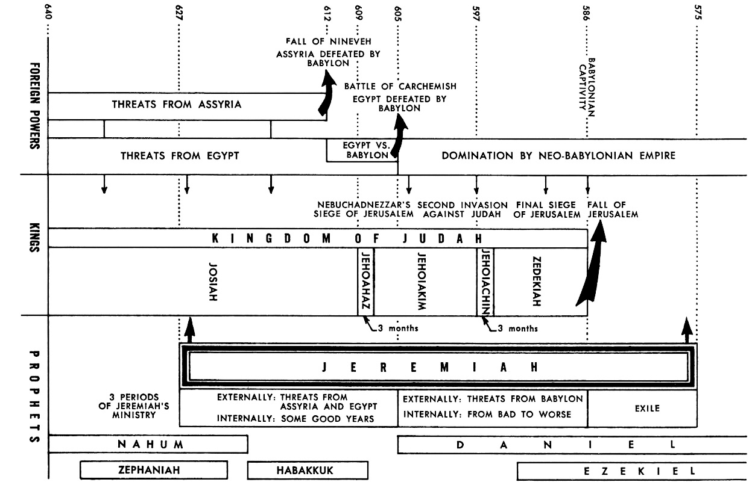

Slide 15
Character Sketch: Who is Jeremiah?

Slide 16
Jeremiah the Prophet: His Name
Jeremiah (Hebrewיִרְמְיָ֖הוּ Yirmeyahu) means “Yahweh throws,” i.e. “lays a foundation, establishes, appoints, or sends”
The Greek form of the Hebrew name in the Septuagint is Hieremias, and the Latin form is Jeremias [Jeremiah, Jeremy]
Seven other Jeremiahs appear in Scripture: 2 Kings 23:31; 1 Chronicles 5:24; 12:4; 12:10, 13; Nehemiah 10:2; 12:1
Jeremiah is mentioned at least nine times outside his book: 2 Chronicles 35:25; 36:12, 21, 22; Daniel 9:2; Ezra 1:1; Matthew 2:17; 16:14; 27:9

Slide 17
Jeremiah the Prophet: His Early Life
Born c. 650 BC in priest-city of Anathoth, NE of Jerusalem
A priest most likely of Abiathar’s line
Born in the reign of King Josiah—the last of Judah’s good kings
Then tragedy and turmoil:
Nineveh destroyed in 612 BC
Josiah killed at Battle of Megiddo in 609 BC
Jehoahaz deposed by Necho II after only three months; Jehoiakim begin to reign
Egypt defeated at Carchemish in 605 BC
First deportation to Babylon in 605 BC
Notes:
The downward slide of the nation continues unabated through a succession of four godless kings. Jehoiakim 609-598 BC.

Slide 19
Jeremiah the Prophet: His Career
One of Judah’s greatest prophets during its darkest days
“Jeremiad”—a long, mournful lament or complaint; a list of woes
The people wallow in apostasy and immorality, growing even more treacherous than Israel (3:1)
Proclaims an approaching avalanche of judgment

Slide 20
Jeremiah the Prophet: His Career
Babylon will be God’s instrument of judgment
Jeremiah’s 164 references are more than the rest of the Bible combined
The will of God is to surrender to Babylon
Jeremiah prophesied the fall of Jerusalem, 70 years of captivity, and return
No ancient nation had ever returned from exile.

Slide 22
Jeremiah the Prophet: His Career
Jeremiah also looked to the far future
The Great tribulation: [30:7] “Alas! That day is so great there is none like it; it is a time of distress for Jacob; yet he shall be saved out of it.”
The New Covenant: [31:31] “Behold, the days are coming, declares the LORD, when I will make a new covenant with the house of Israel and the house of Judah.”
Israel will repent of the rejection of their Messiah
Their new covenant with God that will be written on their hearts (31:31-34, 32:37-40)
Jerusalem will be filled with “the voice of joy and the voice of gladness…” (33:11)

Slide 23
Jeremiah the Prophet: His Career
He foresees the Millennium:
Israel and Judah will be united in peace
Jerusalem will be called “The Throne of the Lord” (3:17-18)
The Righteous Branch will “reign as king and act wisely and do justice and righteousness in the land” (23:5)
The Lord Jesus is Yahweh-Tsidkenu—“The Lord is our righteousness” (23:6)
All the enemies of Israel will be destroyed (30:11)
Jerusalem and the temple will be rebuilt (30:18)
The mourning of the Jewish people will be turned into joy (31:13).
“David shall never lack a man to sit on the throne of the house of Israel” (33:17)

Slide 24
Jeremiah the Weeping Prophet
Jeremiah was overwhelmed with emotion at what he had to do, “overpowered” by God’s words:
[4:19-20] “My anguish, my anguish! I writhe in pain! Oh, the walls of my heart! My heart is beating wildly; I cannot keep silent; for I hear the sound of the trumpet, the alarm of war. Disaster overtakes disaster, the whole land is laid waste.”
[8:21] “For the hurt of my poor people I am hurt, I mourn, and dismay has taken hold of me.”
[9:1] “O that my head were a spring of water, and my eyes a fountain of tears, so that I might weep day and night for the slain of my poor people!”
[15:17] “I did not sit in the company of merrymakers, nor did I rejoice; under the weight of your hand I sat alone, for you had filled me with indignation.”

Slide 25
Jeremiah the Weeping Prophet
Jeremiah spills out his frustration to God much like Job:
[20:7-9] “O Lord, you have enticed me, and I was enticed; you have overpowered me, and you have prevailed. I have become a laughingstock all day long; everyone mocks me… For the word of the Lord has become for me a reproach and derision all day long. If I say, “I will not mention him, or speak any more in his name,” then within me there is something like a burning fire shut up in my bones; I am weary with holding it in, and I cannot.”
[20:14, 18] “Cursed be the day on which I was born!.. Why did I come forth from the womb to see toil and sorrow, and spend my days in shame?”
[15:18] “Why is my pain unceasing, my wound incurable, refusing to be healed? Truly, you are to me like a deceitful brook, like waters that fail.”

Slide 26
Outline of Jeremiah

Slide 27
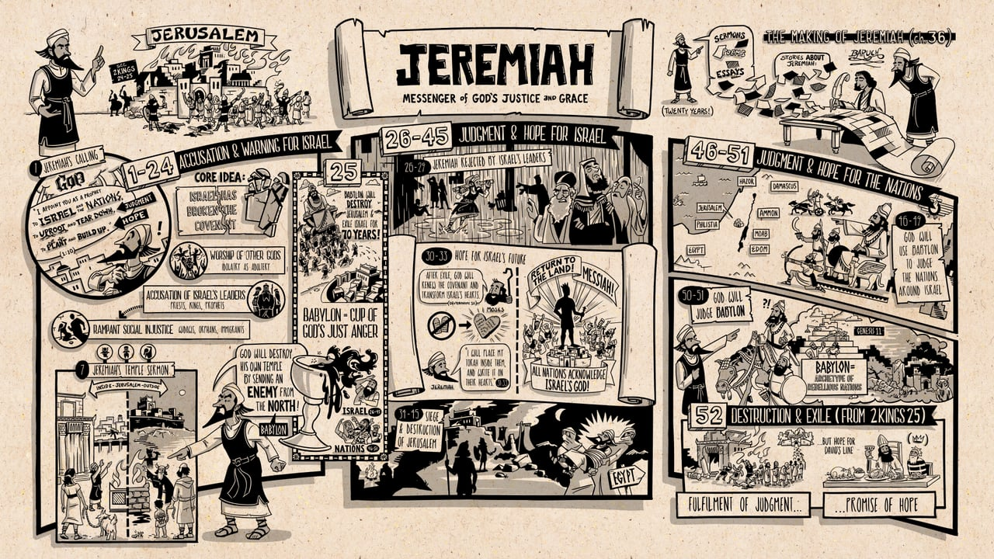

Slide 28
Jeremiah (יִרְמְיָ֖הוּ Yirmeyahu)
The Book of Jeremiah can be divided into twenty-three sections, which are organized into five sub-sections or books.
Introduction (1)
Lament for the sins of Judah in seven sections (2-24)
Review of surrounding nations, foreseeing their destruction and future blessing, in two sections (25; 46–49), with an historical appendix of three sections (26-29)
Hope of restoration and blessing in two sections (30-33), with an historical appendix in three sections (34-35)
Conclusion in two sections (36; 45)
In Egypt, after an interval, Jeremiah added three sections (37-44)
Notes:
Lament for the sins of Judah in seven sections: 1. (2); 2. (3–6); 3. (7–10); 4. (11–13); 5. (14–17:18); 6. (17:19–20); 7. (21–24)
Review of surrounding nations, foreseeing their destruction and future blessing, in two sections: 1. (46–49); 2. (25); with an historical appendix of three sections, 1. (26); 2. (27); 3. (28, 29)
Hope of restoration and blessing in two sections: 1. (30, 31); 2. (32,33); to which is added an historical appendix in three sections: 1. (34:1–7); 2. (34:8-22); 3. (35)
Conclusion in two sections: 1. (36); 2. (45)

Slide 29
Outline of Jeremiah
1-24 Accusation and Warning for Israel

Slide 30
Outline of Jeremiah
1-24 Accusation and Warning for Israel
25 Babylon, the Cup of God’s Just Punishment

Slide 31
Outline of Jeremiah
1-24 Accusation and Warning for Israel
25 Babylon, the Cup of God’s Just Punishment
26-45 Judgment and Hope for Israel

Slide 32
Outline of Jeremiah
1-24 Accusation and Warning for Israel
25 Babylon, the Cup of God’s Just Punishment
26-45 Judgment and Hope for Israel
46-51 Judgment and Hope for the Nations

Slide 33
Outline of Jeremiah
1-24 Accusation and Warning for Israel
25 Babylon, the Cup of God’s Just Punishment
26-45 Judgment and Hope for Israel
46-51 Judgment and Hope for the Nations
52 Appendix from 2 Kings 25— Destruction and Exile

Slide 34
Outline of Jeremiah (1-24)
Accusation and Warning for Israel (1-24)
Jeremiah’s Calling
I appoint you as a prophet to Israel and the nations to uproot and tear down (judgment), and to plant and build up (hope)

Slide 35
Outline of Jeremiah (1-24)
Accusation and Warning for Israel (1-24)
Jeremiah’s Calling
I appoint you as a prophet to Israel and the nations to uproot and tear down (judgment), and to plant and build up (hope)
God’s Indictment
Israel has broken the covenant
Idolatry is adultery
Accusation of Israel’s leaders—prophets, priests, kings
Rampant social injustice—widows, orphans, immigrants
Temple sermon (7)—God will destroy his own temple by sending an enemy from the north

Slide 36
Outline of Jeremiah (25)
Babylon, the Cup of God’s Just Punishment (25)
Babylon is the cup of God’s just anger against Israel and the nations.
Babylon will destroy Jerusalem and exile Israel for 70 years

Slide 37
Outline of Jeremiah (26-45)
Judgment and Hope for Israel (26-45)
Jeremiah rejected by Israel’s leaders (26-29)

Slide 38
Outline of Jeremiah (26-45)
Judgment and Hope for Israel (26-45)
Jeremiah rejected by Israel’s leaders (26-29)
Book of Consolation (30-33)—hope for Israel’s future
After the exile, God will grant Israel a new covenant and transform Israel’s hearts
Messiah will come
All nations will acknowledge Israel’s God

Slide 39
Outline of Jeremiah (26-45)
Judgment and Hope for Israel (26-45)
Jeremiah rejected by Israel’s leaders (26-29)
Book of Consolation (30-33)—hope for Israel’s future
After the exile, God will grant Israel a new covenant and transform Israel’s hearts
Messiah will come
All nations will acknowledge Israel’s God
Siege and destruction of Jerusalem (34-45)

Slide 40
Outline of Jeremiah (46-51)
Judgment and Hope for the Nations (46-51)
God will use Babylon to judge the nations around Israel—Egypt, Philistia, Moab, Ammon, Edom, Damascus, Kedar, Hazor, Elam (46-49)
God will judge Babylon, archetype of all rebellion (50-51)

Slide 41
Outline of Jeremiah (52)
Appendix from 2 Kings 25—Destruction and Exile (52)
Fulfillment of judgment
Promise of hope for David’s Line

Slide 45
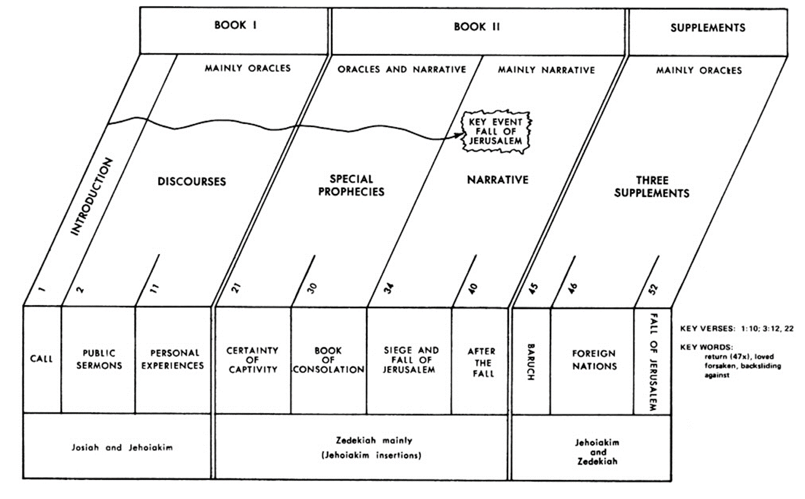

Slide 46
Jeremiah’s Call

Slide 47
Jeremiah’s Call 1:4-19
“Now the word of the LORD came to me, saying, ‘Before I formed you in the womb I knew you, and before you were born I consecrated you; I appointed you a prophet to the nations.’
Then I said, “Ah, Lord GOD! Behold, I do not know how to speak, for I am only a youth [נַעַר infancy to adolescence—Jeremiah was about 15 years old].”
But the LORD said to me, “Do not say, ‘I am only a youth’; for to all to whom I send you, you shall go, and whatever I command you, you shall speak. Do not be afraid of them, for I am with you to deliver you, declares the LORD.”

Slide 48
Jeremiah’s Call 1:4-19
“Then the LORD put out his hand and touched my mouth. And the LORD said to me, ‘Behold, I have put my words in your mouth. See, I have set you this day over nations and over kingdoms, to pluck up and to break down, to destroy and to overthrow, to build and to plant.’”

Slide 49
Jeremiah’s Call 1:4-19
“The word of the LORD came to me” [24/109]
וַיְהִ֤י דְבַר־ יְהוָה֙ אֶֽל־ יִרְמְיָ֔הוּ or וַיְהִ֤י דְבַר־ יְהוָה֙ אֵלַ֥י
[15:16] “Your words were found, and I ate them, and your words became to me a joy and the delight of my heart, for I am called by your name, O LORD, God of hosts.”
[20:9] “There is in my heart as it were a burning fire shut up in my bones, and I am weary with holding it in, and I cannot.”
[16:2] “You shall not take a wife, nor shall you have sons or daughters in this place.”

Slide 50
Jeremiah’s Call 1:4-19
He could never view life the same way once he began to receive God’s Word
Food for his mind and strength for his body
The beauty and the seriousness of the Bible should grip us as teenagers
It meant the loss of popularity and rejection by the world
He goes without the normal joys of life—marriage, a family, social activities—standards are high in God’s service

Slide 51
An almond branch [שָׁקֵ֖ד]—“I am watching [שֹׁקֵ֥ד] over my word to perform it” (1:11)

Slide 52
A boiling pot, facing away from the north—“Out of the north disaster shall be let upon all the inhabitants of the land” (1:13)

Slide 53
Jeremiah’s Call 1:4-19
“I will declare my judgments against them, for all their evil in forsaking me. They have made offerings to other gods and worshiped the works of their own hands.
“But you, dress yourself for work; arise, and say to them everything that I command you. Do not be dismayed by them, lest I dismay you before them. And I, behold, I make you this day a fortified city, an iron pillar, and bronze walls, against the whole land, against the kings of Judah, its officials, its priests, and the people of the land. They will fight against you, but they shall not prevail against you, for I am with you, declares the LORD, to deliver you."

Slide 54
Jeremiah’s Top Ten Verses

Slide 55
Well-Known Phrases: Top Ten
[1:7-10] But the LORD said to me, “Do not say, ‘I am only a youth’; for to all to whom I send you, you shall go, and whatever I command you, you shall speak. Do not be afraid of them, for I am with you to deliver you, declares the LORD.” Then the LORD put out his hand and touched my mouth. And the LORD said to me, “Behold, I have put my words in your mouth. See, I have set you this day over nations and over kingdoms, to pluck up and to break down, to destroy and to overthrow, to build and to plant.”

Slide 56
Well-Known Phrases: Top Ten
[15:16] Your words were found, and I ate them, and your words became to me a joy and the delight of my heart, for I am called by your name, O LORD, God of hosts.

Slide 57
Well-Known Phrases: Top Ten
[31:3] “The LORD appeared to him from far away. I have loved you with an everlasting love; therefore I have continued my faithfulness to you [KJV: Yea, I have loved thee with an everlasting love: therefore with lovingkindness have I drawn thee].”

Slide 58
Well-Known Phrases: Top Ten
[23:5-6] “Behold, the days are coming, declares the LORD, when I will raise up for David a righteous Branch, and he shall reign as king and deal wisely, and shall execute justice and righteousness in the land. In his days Judah will be saved, and Israel will dwell securely. And this is the name by which he will be called: ‘The LORD is our righteousness [Jehovah Tsidkenu (McCheyne)].’”

Slide 59
Well-Known Phrases: Top Ten
[6:16] Thus says the LORD: “Stand by the roads, and look, and ask for the ancient paths, where the good way is; and walk in it, and find rest for your souls.” But they said, “We will not walk in it.”

Slide 60
Well-Known Phrases: Top Ten
[1:5] “Before I formed you in the womb I knew you, and before you were born I consecrated you; I appointed you a prophet to the nations.”

Slide 61
Well-Known Phrases: Top Ten
[33:2-3] “Thus says the LORD who made the earth, the LORD who formed it to establish it—the LORD is his name: Call to me and I will answer you, and will tell you great and hidden things that you have not known.”

Slide 62
Well-Known Phrases: Top Ten
[31:31-34] “Behold, the days are coming, declares the LORD, when I will make a new covenant with the house of Israel and the house of Judah, not like the covenant that I made with their fathers on the day when I took them by the hand to bring them out of the land of Egypt, my covenant that they broke, though I was their husband, declares the LORD. But this is the covenant that I will make with the house of Israel after those days, declares the LORD: I will put my law within them, and I will write it on their hearts. And I will be their God, and they shall be my people. And no longer shall each one teach his neighbor and each his brother, saying, ‘Know the LORD,’ for they shall all know me, from the least of them to the greatest, declares the LORD. For I will forgive their iniquity, and I will remember their sin no more.”

Slide 63
Well-Known Phrases: Top Ten
[17:9-10] The heart is deceitful above all things, and desperately sick; who can understand it? “I the LORD search the heart and test the mind, to give every man according to his ways, according to the fruit of his deeds.”

Slide 64
Well-Known Phrases: Top Ten
[29:11-13] “For I know the plans I have for you, declares the LORD, plans for welfare and not for evil, to give you a future and a hope. Then you will call upon me and come and pray to me, and I will hear you. You will seek me and find me, when you seek me with all your heart.”

Slide 65
Other Well-Known Phrases from Jeremiah
[2:13] “For my people have committed two evils: they have forsaken me, the fountain of living waters, and hewed out cisterns for themselves, broken cisterns that can hold no water.”
[8:11] “They have healed the wound of my people lightly, saying, ‘Peace, peace,’ when there is no peace.”

Slide 66
Other Well-Known Phrases from Jeremiah
[8:20-22] “The harvest is past, the summer is ended, and we are not saved.” For the wound of the daughter of my people is my heart wounded; I mourn, and dismay has taken hold on me. Is there no balm in Gilead? Is there no physician there? Why then has the health of the daughter of my people not been restored?
[12:5] “If you have raced with men on foot, and they have wearied you, how will you compete with horses? And if in a safe land you are so trusting, what will you do in the thicket of the Jordan [KJV: the swelling of Jordan]?”

Slide 67
Jeremiah’s Ministry and Message

Slide 68
Prophecy
Forth-telling—concern with the present
Religious, ethical, and political corruption
Foretelling—concern with the future
What will happen if the people don’t change?
Is there hope?

Slide 70
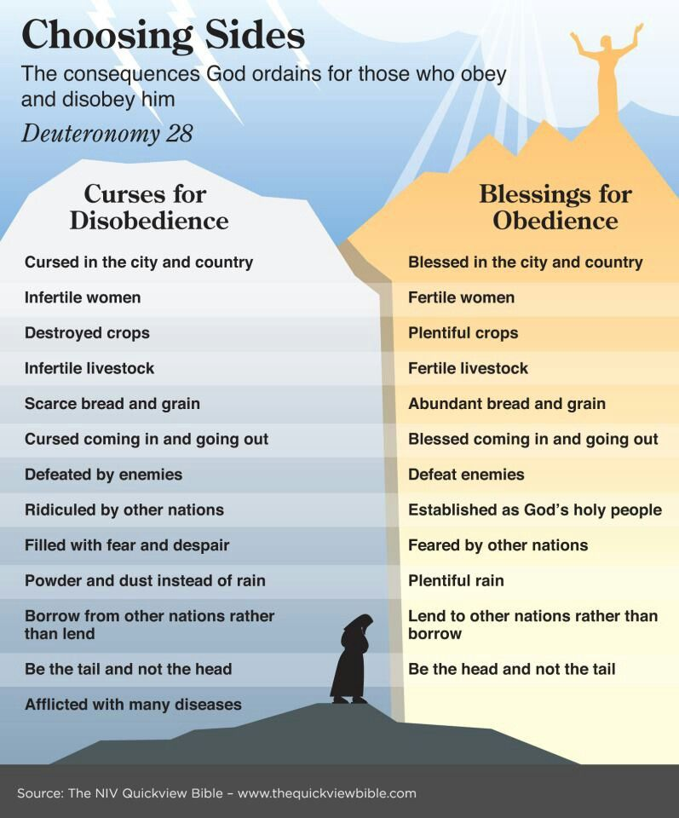

Slide 71
Seven Symbolic Actions 1. A ruined and useless belt (13:1-11) Redemption brought an intimate relationship and priestly privilege Israel squandered and lost its holiness

Slide 72
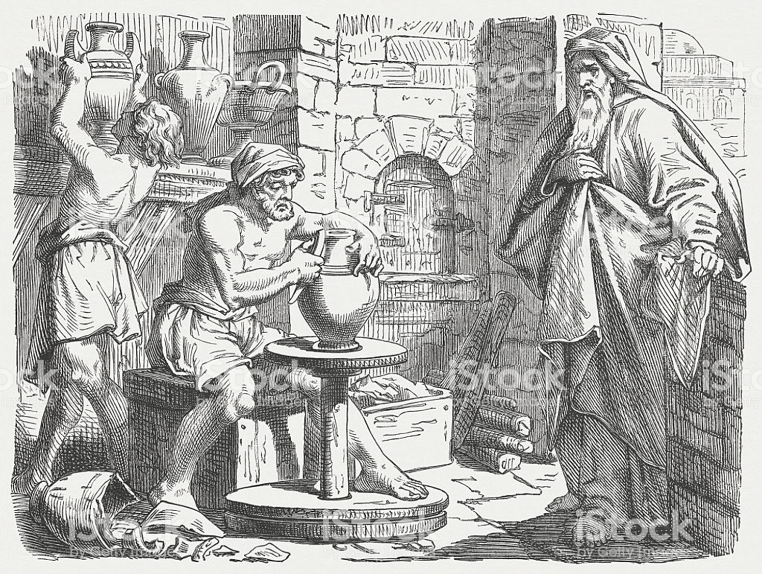
Seven Symbolic Actions 2. A smashed clay jar (18, 19:1-12) Moist and pliable clay can be reshaped Hardened pottery can only be smashed

Slide 73
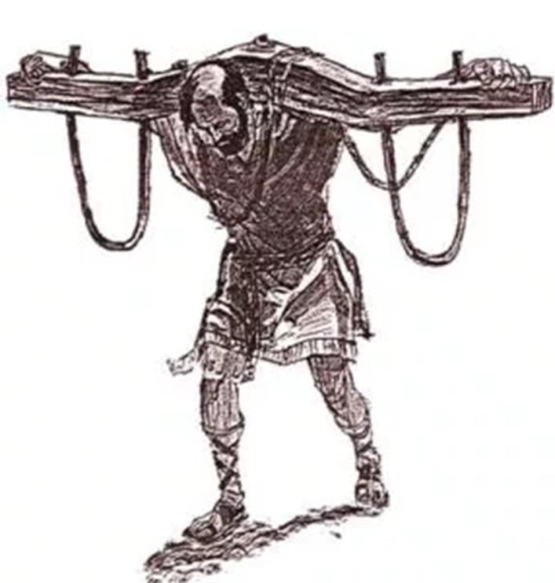
Seven Symbolic Actions 3. A yoke of straps and crossbars (27-28) Judah’s doom is now fixed God’s will is to submit to Babylon

Slide 74
Seven Symbolic Actions 4. A purchased field in Anathoth (32:6-15) Jeremiah acts as a kinsman-redeemer Deed sealed in jar of clay Land will be claimed in a coming day

Slide 75
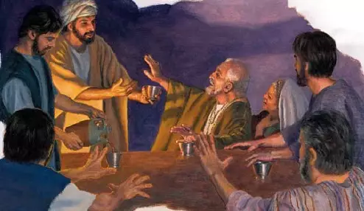
Seven Symbolic Actions 5. The loyal Rechabites (35) Faithfulness and sincerity in the midst of treachery and duplicity

Slide 76
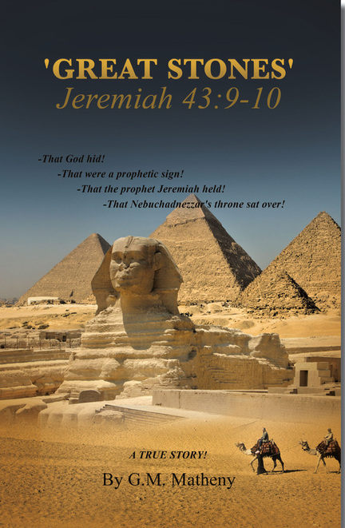
Seven Symbolic Actions 6. Large stones in a brick pavement of Pharaoh’s palace (43:8-11) Egypt is no refuge—Nebuchadnezzar will set his throne over these stones

Slide 77
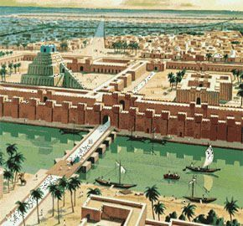
Seven Symbolic Actions 7. Scroll of Babylon’s doom tied to a stone and sunk in the Euphrates (51:59-64) “So will Babylon sink to rise no more.”

Slide 78
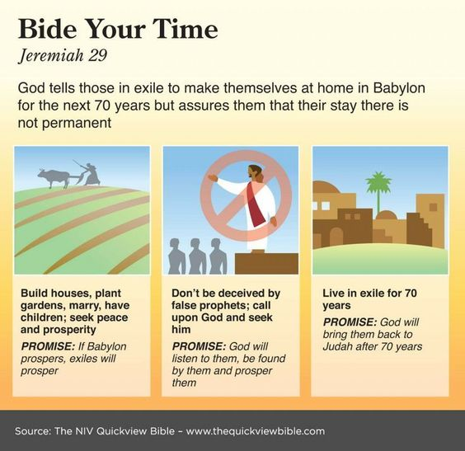

Slide 79
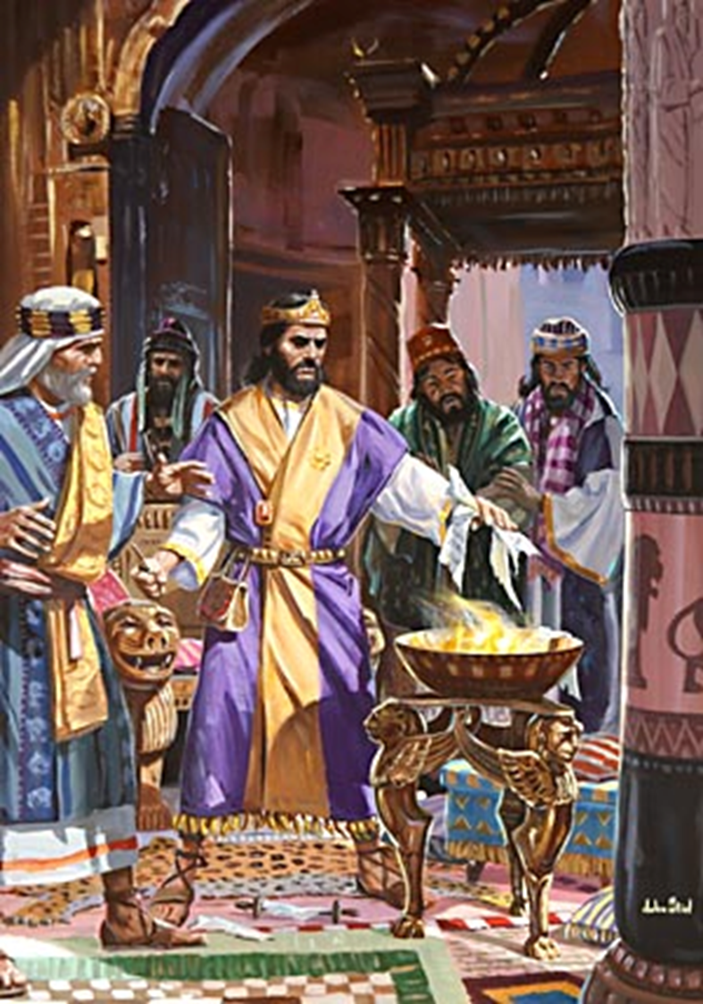
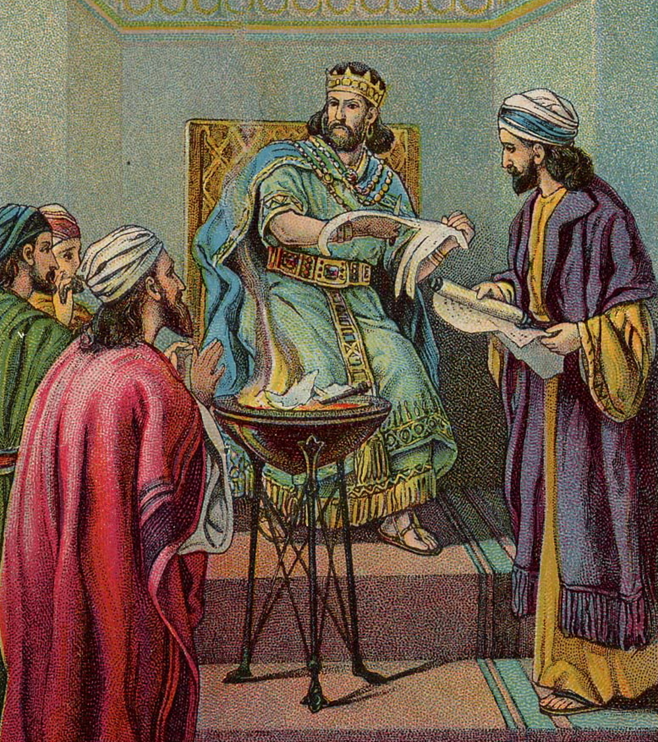
36:22-26—Jehoiakim Burns the Scroll

Slide 80
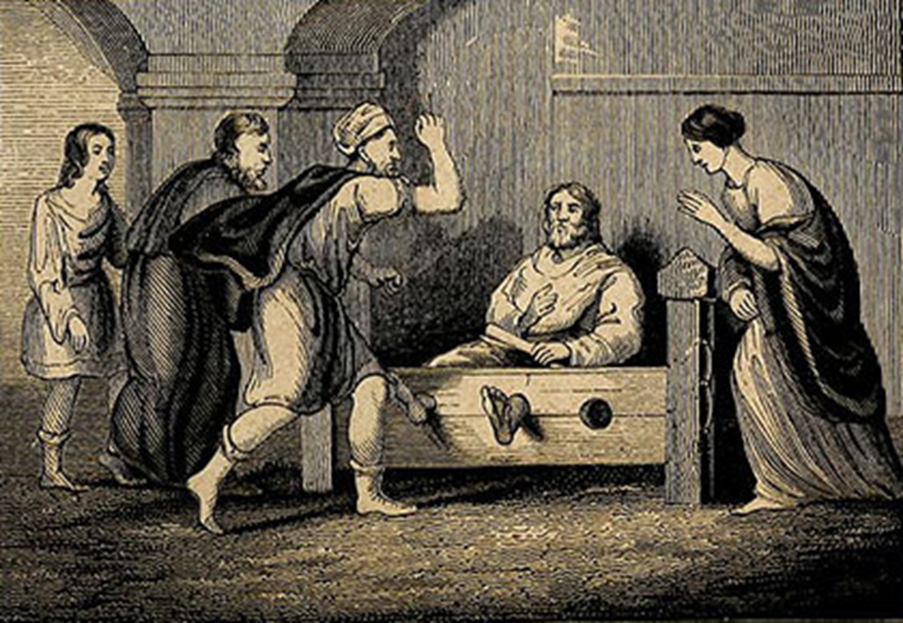
20:2—Then Pashhur beat Jeremiah the prophet, and put him in the stocks that were in the upper Benjamin Gate of the house of the LORD.

Slide 81
An Ancient Cistern in Israel
“And there was no water in the cistern, but only mud, and Jeremiah sank in the mud” (38:6).

Slide 82
Ebed-Melech Supervising Jeremiah’s Rescue (38:7-13)

Slide 83
NT Quotations from Jeremiah

Slide 84
Jeremiah Quoted: Daniel 9:2
“In the first year of his reign, I, Daniel, perceived in the books the number of years that, according to the word of the LORD to Jeremiah the prophet, must pass before the end of the desolations of Jerusalem, namely, seventy years.”
[Jeremiah 25:11-12] “This whole land shall become a ruin and a waste, and these nations shall serve the king of Babylon seventy years. Then after seventy years are completed, I will punish the king of Babylon and that nation, the land of the Chaldeans, for their iniquity, declares the LORD, making the land an everlasting waste.”
[Jeremiah 29:10] “For thus says the LORD: When seventy years are completed for Babylon, I will visit you, and I will fulfill to you my promise and bring you back to this place.”

Slide 85
Jeremiah Quoted: Matthew 2:17-18
“Then was fulfilled what was spoken by the prophet Jeremiah: ‘A voice was heard in Ramah, weeping and loud lamentation, Rachel weeping for her children; she refused to be comforted, because they are no more.’”
[Jeremiah 31:15] “Thus says the LORD: ‘A voice is heard in Ramah, lamentation and bitter weeping. Rachel is weeping for her children; she refuses to be comforted for her children, because they are no more.’”

Slide 86
Jeremiah Quoted: Matthew 27:9
“Then was fulfilled what had been spoken by the prophet Jeremiah, saying, ‘And they took the thirty pieces of silver, the price of him on whom a price had been set by some of the sons of Israel, and they gave them for the potter’s field, as the Lord directed me.’”
[Jeremiah 18:1-2] “The word that came to Jeremiah from the LORD: ‘Arise, and go down to the potter’s house, and there I will let you hear my words.”
[Jeremiah 19:2, 11] “Go out to the Valley of the Son of Hinnom at the entry of the Potsherd Gate, and proclaim there the words that I tell you… ‘Thus says the LORD of hosts: So will I break this people and this city, as one breaks a potter’s vessel, so that it can never be mended. Men shall bury in Topheth because there will be no place else to bury.’”
[Jeremiah 32:6-9] “Jeremiah said, ‘The word of the LORD came to me: Behold, Hanamel the son of Shallum your uncle will come to you and say, “Buy my field that is at Anathoth, for the right of redemption by purchase is yours.’ Then Hanamel my cousin came to me in the court of the guard, in accordance with the word of the LORD, and said to me, ‘Buy my field that is at Anathoth in the land of Benjamin, for the right of possession and redemption is yours; buy it for yourself.’ Then I knew that this was the word of the LORD. And I bought the field at Anathoth from Hanamel my cousin, and weighed out the money to him, seventeen shekels of silver.”
Notes:
With Zechariah 11:13

Slide 87
Jeremiah Quoted: Mark 11:17
“Is it not written, ‘My house shall be called a house of prayer for all the nations[Isaiah 56:7]’? But you have made it a den of robbers.”
Also quoted in Mark 11:17 and Luke 19:46
[Jeremiah 7:11] “Has this house, which is called by my name, become a den of robbers in your eyes? Behold, I myself have seen it, declares the LORD.”
Notes:
With Zechariah 11:13

Slide 88
Jeremiah Quoted: 1 Corinthians 1:31
“So that, as it is written, ‘Let the one who boasts, boast in the Lord.’”
[Jeremiah 9:23-24] “Thus says the LORD: ‘Let not the wise man boast in his wisdom, let not the mighty man boast in his might, let not the rich man boast in his riches, but let him who boasts boast in this, that he understands and knows me, that I am the LORD who practices steadfast love, justice, and righteousness in the earth. For in these things I delight, declares the LORD.’”
Notes:
With Zechariah 11:13

Slide 89
Jeremiah Quoted: 2 Corinthians 10:17
“Let the one who boasts, boast in the Lord.”
[Jeremiah 9:23-24] “Thus says the LORD: ‘Let not the wise man boast in his wisdom, let not the mighty man boast in his might, let not the rich man boast in his riches, but let him who boasts boast in this, that he understands and knows me, that I am the LORD who practices steadfast love, justice, and righteousness in the earth. For in these things I delight, declares the LORD.’”
Notes:
With Zechariah 11:13

Slide 90
Jeremiah Quoted: Hebrews 8:8-12
“For he finds fault with them when he says: ‘Behold, the days are coming, declares the Lord, when I will establish a new covenant with the house of Israel and with the house of Judah, not like the covenant that I made with their fathers on the day when I took them by the hand to bring them out of the land of Egypt. For they did not continue in my covenant, and so I showed no concern for them, declares the Lord. For this is the covenant that I will make with the house of Israel after those days, declares the Lord: I will put my laws into their minds, and write them on their hearts, and I will be their God, and they shall be my people. And they shall not teach, each one his neighbor and each one his brother, saying, “Know the Lord,” for they shall all know me, from the least of them to the greatest. For I will be merciful toward their iniquities, and I will remember their sins no more’” [cf. Jeremiah 31:31-34].
Notes:
With Zechariah 11:13

Slide 91
Jeremiah Quoted: Hebrews 10:16-17
“This is the covenant that I will make with them after those days, declares the Lord: I will put my laws on their hearts, and write them on their minds,” then he adds, “I will remember their sins and their lawless deeds no more” [cf. Jeremiah 31:33, 34].
Notes:
With Zechariah 11:13

Slide 92
Pictures and Prophecies of Christ

Slide 94
Judgment of Foreign Nations

Slide 96
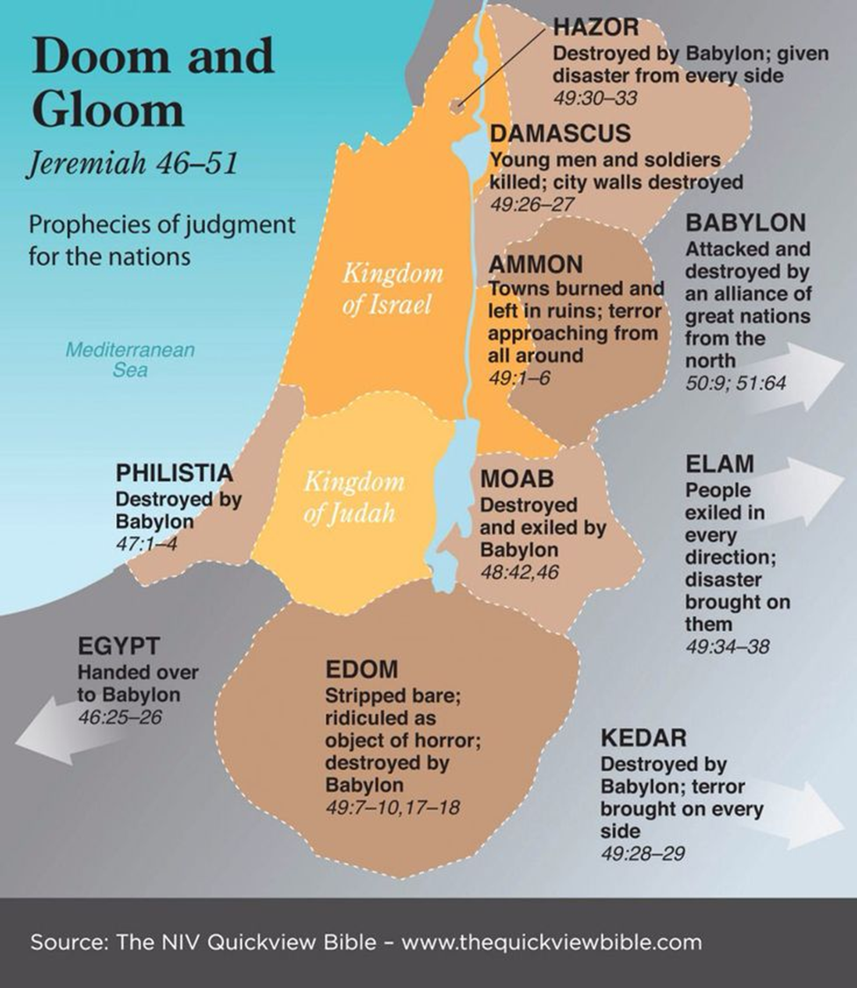

Slide 97
Judgment on Elam 49:34-39

Slide 98
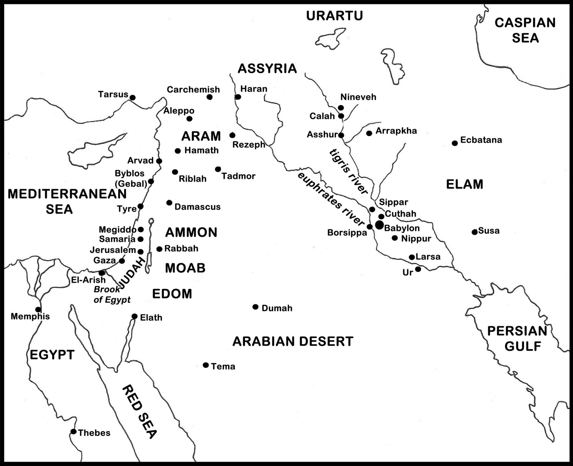

Slide 99
Jeremiah Lamenting the Destruction of Jerusalem Rembrandt van Rijn

